Slide 5
WEAPONS OF OUR WARFARE
2Co 10:3 For though we walk in the flesh, we do not war after the flesh:
2Co 10:4 (For the weapons of our warfare are not carnal, but mighty through God to the pulling down of strong holds;)

Slide 6
WAR
Psa 18:34 He teacheth my hands to war, so that a bow of steel is broken by mine arms.
Psa 144:1 A Psalm of David. Blessed be the LORD my strength, which teacheth my hands to war, and my fingers to fight:
Psa 44:5 Through thee will we push down our enemies: through thy name will we tread them under that rise up against us.

Slide 9
LIFE AND LIGHT
Rom 13:11 And that, knowing the time, that now it is high time to awake out of sleep: for now is our salvation nearer than when we believed.
Rom 13:12 The night is far spent, the day is at hand: let us therefore cast off the works of darkness, and let us put on the armour of light.
Rom 13:13 Let us walk honestly, as in the day; not in rioting and drunkenness, not in chambering and wantonness, not in strife and envying.
Rom 13:14 But put ye on the Lord Jesus Christ, and make not provision for the flesh, to fulfil the lusts thereof.

Slide 10
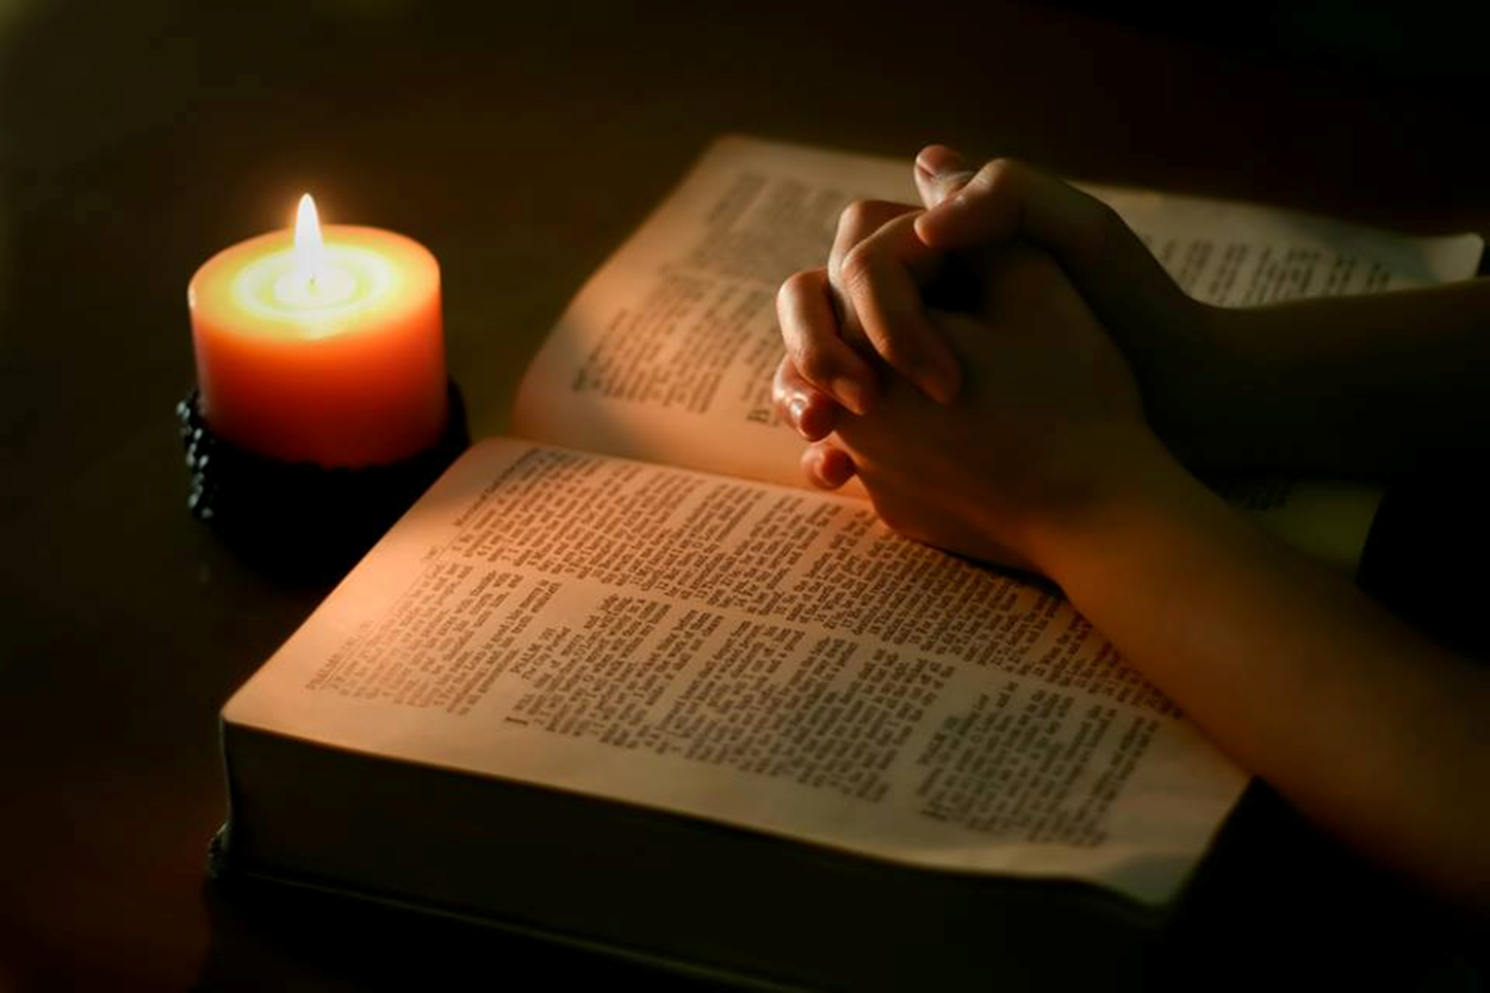
“We are not safe a moment unless guided and controlled by the Holy Spirit.” Our High Calling,
p.187
“There is not an impulse of our nature, not a faculty of the mind, or an inclination of the heart, but needs to be, moment by moment, under the control of the Spirit of God.” PP 421
Satan well knows that all whom he can lead to neglect prayer and the searching of the Scriptures, will be overcome by his attacks.– The Great Controversy, p. 519. (1888)

Slide 11
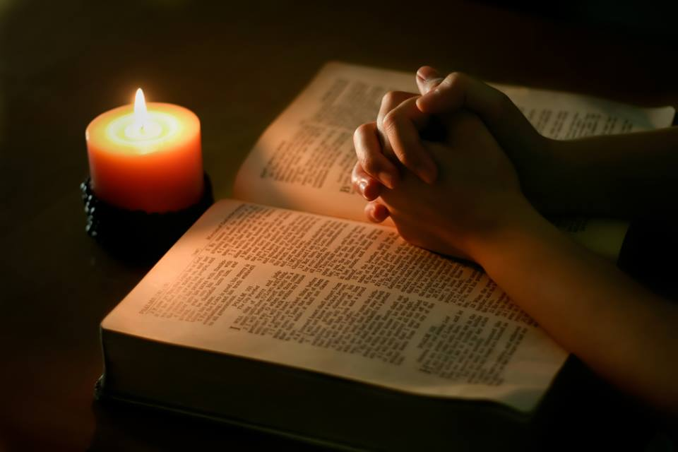
8T 46 “We need the breath of the divine life breathed unto us . . . . Floods of spiritual power are to be poured forth upon those prepared to receive it, ”

Slide 15
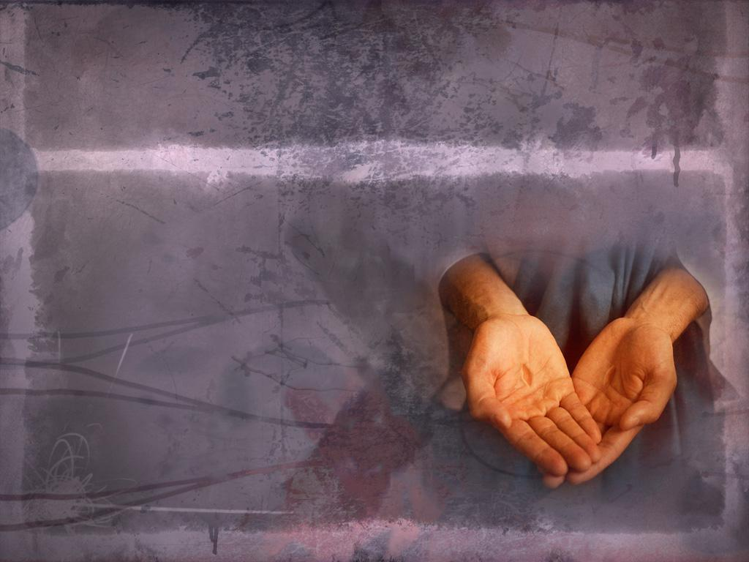
Isaiah 52:1 Awake, awake; put on thy strength, O Zion; put on thy beautiful garments, O Jerusalem, the holy city: for henceforth there shall no more come into thee the uncircumcised and the unclean

Slide 16
Romans 13:12,14 The night is far spent, the day is at hand: let us therefore cast off the works of darkness, and let us put on the armour of light.But put ye on the Lord Jesus Christ, and make not provision for the flesh, to fulfil the lusts thereof
1 Thessalonians 5:8 But let us, who are of the day, be sober, putting on the breastplate of faith and love; and for an helmet, the hope of salvation.

Slide 17
Isaiah 61:3 To appoint unto them that mourn in Zion, to give unto them beauty for ashes, the oil of joy for mourning, the garment of praise for the spirit of heaviness; that they might be called trees of righteousness, the planting of the LORD, that he might be glorified.
Isaiah 63:10 I will greatly rejoice in the LORD, my soul shall be joyful in my God; for he hath clothed me with the garments of salvation, he hath covered me with the robe of righteousness, as a bridegroom decketh himself with ornaments, and as a bride adorneth herself with her jewels.

Slide 19
22c and shoes on his feet: Isaiah 52:7 How beautiful upon the mountains are the feet of him that bringeth good tidings, that publisheth peace; that bringeth good tidings of good, that publisheth salvation; that saith unto Zion, Thy God reigneth!
Genesis 41:43 And he made him to ride in the second chariot which he had; Esther 8:13 The copy of the writing for a commandment to be given in every province was published unto all people, ... 14 So the posts that rode upon mules and camels went out, being hastened and pressed on by the king's commandment. And the decree was given at Shushan the palace.

Slide 20
Ephesians 6:15 And your feet shod with the preparation of the gospel of peace; Revelation 14:6 And I saw another angel fly in the midst of heaven, having the everlasting gospel to preach unto them that dwell on the earth, and to every nation, and kindred, and tongue, and people, 7 Saying with a loud voice, Fear God, and give glory to him; for the hour of his judgment is come: and worship him that made heaven, and earth, and the sea, and the fountains of waters. Romans 10:15 And how shall they preach, except they be sent? as it is written, How beautiful are the feet of them that preach the gospel of peace, and bring glad tidings of good things!

Slide 24
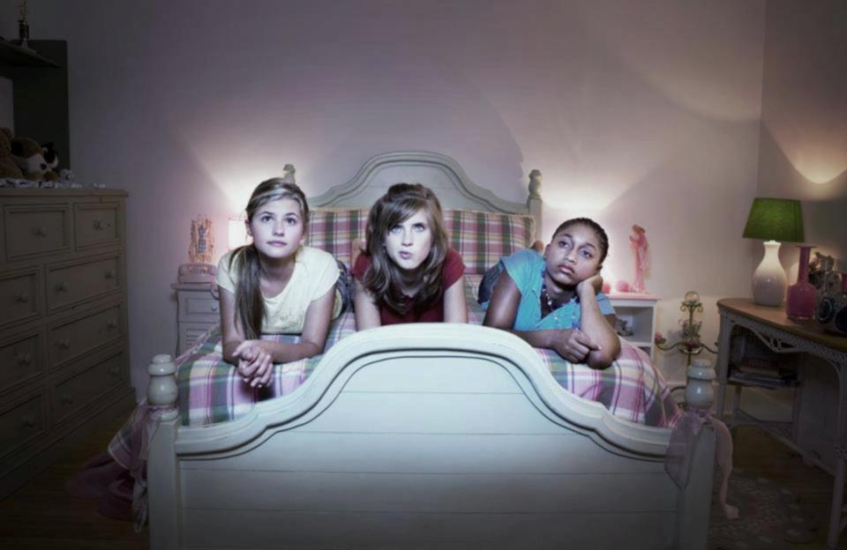
The youth especially stumble over this phrase, "a new heart." They do not know what it means. They look for a special change to take place in their feelings. This they term conversion. Over this error thousands have stumbled to ruin, not understanding the expression, "Ye must be born again." John 3:7. {OHC 159.3}

Slide 25
Satan leads people to think that because they have felt a rapture of feeling, they are converted. But their experience does not change. Their actions are the same as before. Their lives show no good fruit. They pray often and long, and are constantly referring to the feelings they had at such and such a time. But they do not live the new life. They are deceived. Their experience goes no deeper than feeling. They build upon the sand, and when adverse winds come, their house is swept away. . . . {OHC 159.4}

Slide 26
When Jesus speaks of the new heart, He means the mind, the life, the whole being. To have a change of heart is to withdraw the affections from the world, and fasten them upon Christ. To have a new heart is to have a new mind, new purposes, new motives. What is the sign of a new heart?--A changed life.

Slide 28
We know the dangers and temptations that beset the youth at the present time are not few or small. . . . We live in an age when to resist evil calls for constant watchfulness and prayer. God's precious Word is the standard for youth who would be loyal to the King of heaven. Let them study the Scriptures.

Slide 29
Let them commit text after text to memory, and acquire a knowledge of what the Lord has said. . . . And in trial let the youth spread out the Word of God before them, and with humble hearts, and in faith, seek the Lord for wisdom to find out His way, and for strength to walk in it. . . .

Slide 31
Those who fail to realize their constant dependence upon God will be overcome by temptation. We may now suppose that our feet stand secure, and that we shall never be moved. We may say with confidence, “I know in whom I have believed; nothing can shake my faith in God and in His word.” Desire of ages page 382.4

Slide 32
But Satan is planning to take advantage of our hereditary and cultivated traits of character, and to blind our eyes to our own necessities and defects. Only through realizing our own weakness and looking steadfastly unto Jesus can we walk securely.
Desire of ages page 382.4

Slide 33
Resist the limited foe Satan is constantly at work, but few have any idea of his activity and subtlety. The people of God must be prepared to withstand the wily foe. It is this resistance that Satan dreads. He knows better than we do the limit of his power and how easily he can be overcome if we resist and face him. {5T 293.4}

Slide 34
Through divine strength the weakest saint is more than a match for him and all his angels, and if brought to the test he would be able to prove his superior power. Therefore Satan's step is noiseless, his movements stealthy, and his batteries masked. He does not venture to show himself openly, lest he arouse the Christian's dormant energies and send him to God in prayer.
{5T 293.4}

Slide 35
The enemy cannot overcome the humble learner of Christ, the one who walks prayerfully before the Lord. Christ interposes Himself as a shelter, a retreat, from the assaults of the wicked one. The promise is given, "When the enemy shall come in like a flood, the Spirit of the Lord shall lift up a standard against him." . . .

Slide 36
1 Cor 15:57

Slide 38
Beyond the discipline of the home and the school, all have to meet the stern discipline of life. How to meet this wisely is a lesson that should be made plain to every child and to every youth. It is true that God loves us, that He is working for our happiness, and that, if His law had always been obeyed, we should never have known suffering; and it is no less true that, in this world, as the result of sin, suffering, trouble, burdens, come to every life.

Slide 39
We may do the children and the youth a lifelong good by teaching them to meet bravely these troubles and burdens. While we should give them sympathy, let it never be such as to foster self-pity. What they need is that which stimulates and strengthens rather than weakens.

Slide 41
Those who in harmony with God, and through faith in Him, receive strength to resist wrong, and stand in defense of the right, will always have severe conflicts and will frequently have to stand almost alone. But precious victories will be theirs while they make God their dependence. Their moral sense will be keen, clear, and sensitive. Their moral powers will be equal to withstand wrong influences. Their integrity, like that of Moses, of the purest character.

Slide 44
{RH, May 8, 1888 par. 9}
Our work is an aggressive one, and as faithful soldiers of Jesus, we must bear the blood-stained banner into the very strongholds of the enemy. "We wrestle not against flesh and blood, but against principalities, against powers, against the rulers of the darkness of this world, against spiritual wickedness in high places."

Slide 45
In vision I saw two armies in terrible conflict. One army was led by banners bearing the world's insignia; the other was led by the blood-stained banner of Prince Emmanuel. Standard after standard was left to trail in the dust as company after company from the Lord's army joined the foe; and tribe after tribe from the ranks of the enemy united with the commandment-keeping people of God. {PH109 1.1}

Slide 46
The battle raged. Victory alternated from side to side. Now the soldiers of the cross gave way, "as when a standard-bearer fainteth." But their apparent retreat was but an effort to gain a more advantageous position. Shouts of joy were heard. A song of praise to God went up, and angel voices united in the song, as Christ's soldiers planted His banner on the walls of fortresses till then held by the enemy. {PH109 2.1}

Slide 47
The Captain of our salvation was ordering the battle and sending support to His soldiers. His power was mightily displayed, encouraging them to press the battle to the gates. He taught them terrible things in righteousness as He led them on step by step, conquering and to conquer. {PH109 2.1}

Slide 48
At last the victory was gained. The army following the banner with the inscription, "The commandments of God, and the faith of Jesus," was gloriously triumphant. The soldiers of Christ were close beside the gates of the city of God, and with joy the city received her King. The kingdom of peace and joy and everlasting righteousness was established. God's will was done on earth, as it is done in heaven. {PH109 2.1}

Slide 49
OUR WORK
This is the scene that is presented to me. But the church must still fight against seen and unseen foes. Satanic agencies in human form are on the ground. Men have confederated to oppose the Lord of hosts. These confederacies will continue until Christ shall leave His place of intercession before the mercy-seat, and shall put on the garments of vengeance.
{PH109 2.1}

Slide 50
OUR WORK
Satanic agencies are in every city, busily organizing into parties those opposed to the law of God. Professed saints and avowed unbelievers take their stand with these parties. This is no time for the people of God to be weaklings. We can not afford to be off our guard for one moment.
{PH109 2.1}

Slide 51
AGGRESSIVE CHRISTIANITY
True Christianity will always be aggressive, and wherever it exists, it will arouse enmity. All who live a conscientious life, who bear testimony of the claims of God, of the evil of sin, of the judgment to come, will be called the disturbers of Israel. {PC 146.2}

Slide 52
AGGRESSIVE CHRISTIANITY
Those whose testimony awaken the apprehension of the soul, offend pride, and arouse opposition. The hatred of evil against good exists as surely now as in the days of Christ, when the multitude cried, "Away with Him!" "Release unto us Barabbas."

Slide 53
AGGRESSIVE CHRISTIANITY
There is no kind of evil in our world, but that some have an interest in maintaining it. Evil is ever warring against good. And since we know that the conflict with the prince of darkness is constant, and must be severe, let us be united in the warfare. Cease to war against those of your own faith. Let no one help Satan in his work. . . . {PC 146.3}

Slide 54
An Army of Workers
The Lord Jesus desires the members of His church to be an army of workers, laboring for Him according to their varied capabilities, and carrying out the principles of self-denial and self-sacrifice, preserving that love for God which drew them away from the world and which will draw them together, away from separate confederacies, from distant, detached parties. {MM 316.1}

Slide 55
An Army of Workers
The work is to be one grand, harmonious whole in Christ Jesus. The faith that works by love and purifies the soul is the holy, uplifting, sanctifying agency which is to soften and subdue jarring human nature. {MM 316.1}

Slide 56
An Army of Workers
The love of Christ is to constrain the believers, causing them to blend in harmonious action at the cross of Calvary. As they live the principles which separated them from the world, they will be bound to one another by the sacred cords of Christian love. {MM 316.1}

