Slide 1
The Birth of a Movement
William Miller, 1844, and the Great Disappointment

Slide 2
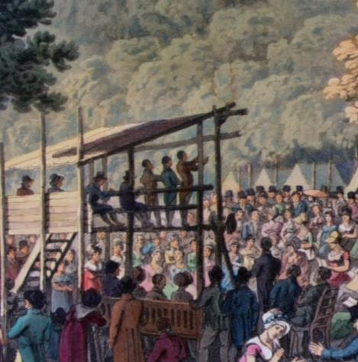
The Great Awakenings
1st – 1730’s-1740’s Mostly focused Christians
2nd – 1800-1860’s Focused on the Lost
-B

Slide 3
An Important Year
1844

Slide 4
1830’s-1840’s – Times of Change
1830 – Joseph Smith starts the Church of the Latter-day Saints (Mormons)
Charles Darwin - Theory of Evolution
Karl Marx – Communism (Manifesto -1848)
Transcendentalist Movement in Full Swing
July 1841 – David Livingston arrives in Africa
May 1844 – The Bahai Faith is founded

Slide 5
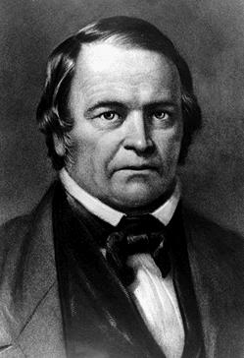
William Miller
-Born: 1782
-Died: 1849
-Deism: belief in the existence of a supreme being, specifically of a creator who does not intervene in the universe.

Slide 6
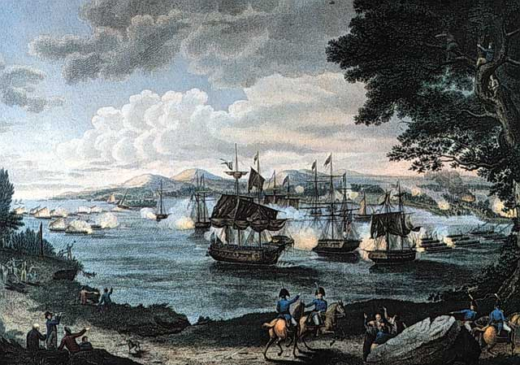
William Miller – War of 1812

Slide 7
William Miller – Low Hampton, NY

Slide 8
William Miller – Low Hampton, NY

Slide 9
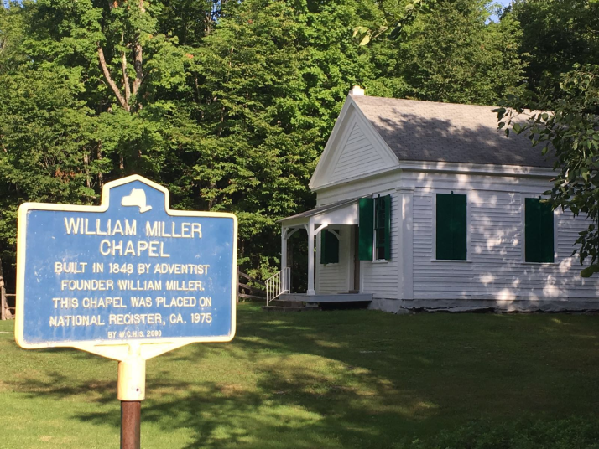
William Miller – Low Hampton, NY

Slide 10
Cleansing of the Sanctuary
Daniel 8:14
What was the Sanctuary that was to be cleansed?
Convinced in 1818
Started Preaching 1831
Received license from the Baptist Church to preach in 1833

Slide 11
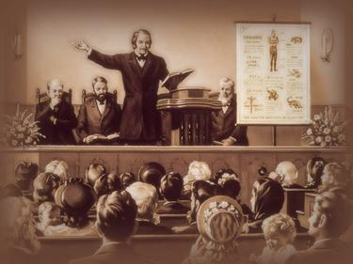
Jesus is Coming!

Slide 12
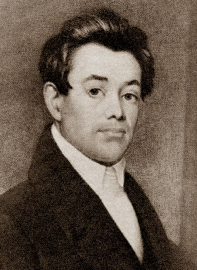
The Movement Grows
-Joshua Himes
-Pastor from Boston, MA
-Heard Miller in 1839
-Started publishing Miller’s message in 1840 in the Signs of the Times
-Accepted ideas in 1842

Slide 13
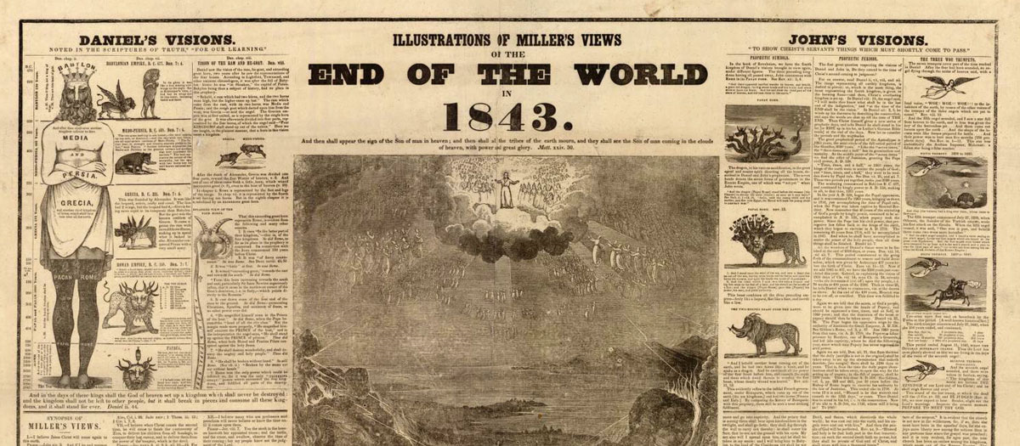
The Movement Grows

Slide 14
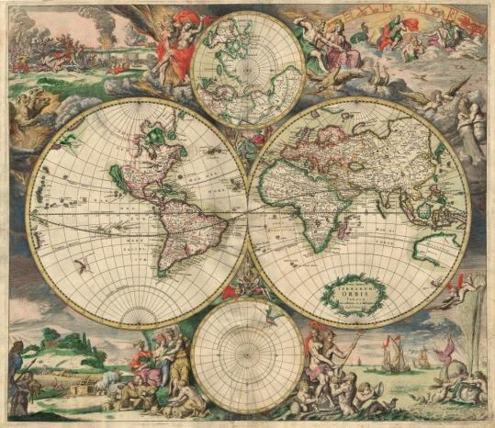
The Movement Grows
Northeast
Canada
Australia
England
Norway
Chile

Slide 15
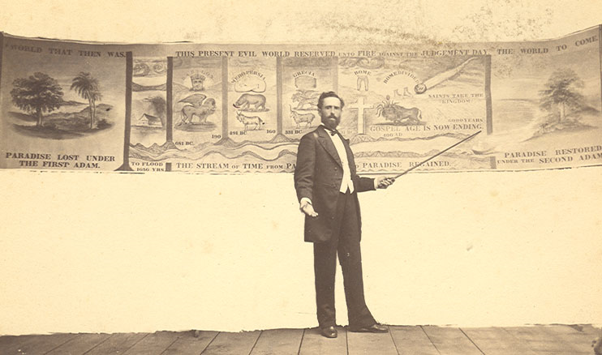
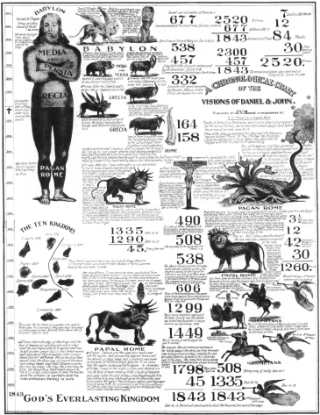
The Movement Grows

Slide 16
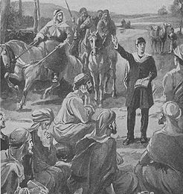
Other Preachers
Joseph Wolff
Converted Jew
1821-1845 Missionary Travels
Africa, Middle East, USA
Didn’t set a date but believe Jesus would come soon

Slide 17
Other Preachers
“A similar belief was found by another missionary to exist in Tatary (Middle Asia). A Tatar priest put the question to the missionary as to when Christ would come the second time. When the missionary answered that he knew nothing about it, the priest seemed greatly surprised as such ignorance in one who professed to be a Bible teacher, and stated his own belief, founded on prophecy, that Christ would come about 1844.”
-The Great Controversy, p. 362.1

Slide 18
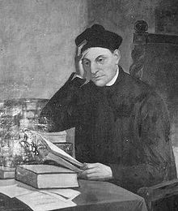
Other Preachers
Manuel Lacunza
1731-c.1801
Spanish Jesuit
Believed in Jesus Return
Published views under name “Rabbi Ben-Ezra”
Translated to English 1825

Slide 19
Other Preachers
In South America, in the midst of barbarism and priestcraft, Lacunza, a Spaniard and a Jesuit, found his way to the Scriptures, and thus received the truth of Christ's speedy return. Impelled to give the warning, yet desiring to escape the censures of Rome, he published his views under the assumed name of “Rabbi Ben-Israel,” representing himself as a converted Jew. Lacunza lived in the eighteenth century, but it was about 1825 that his book, having found its way to London, was translated into the English language. Its publication served to deepen the interest already awakening in England in the subject of the second advent. {GC88 362.3}

Slide 20
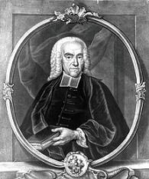
Other Preachers
Johann Albrecht Bengel
1687-1752
German, Lutheran Minister
Set date for Jesus return in 1836

Slide 21
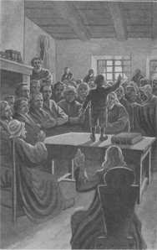
Other Preachers
Child Preachers in Scandinavia
1840’s
Preached of Jesus’ soon return to thousands

Slide 22
Other Preachers
It was God's will that the tidings of the Saviour's coming should be given in the Scandinavian countries; and when the voices of His servants were silenced, He put His Spirit upon the children, that the work might be accomplished. When Jesus drew near to Jerusalem attended by the rejoicing multitudes that, with shouts of triumph and the waving of palm branches, heralded Him as the Son of David, the jealous Pharisees called upon Him to silence them; but Jesus answered that all this was in fulfillment of prophecy, and if these should hold their peace, the very stones would cry out. The people, intimidated by the threats of the priests and rulers, ceased their joyful proclamation as they entered the gates of Jerusalem; but the children in the temple courts afterward took up the refrain, and, waving their branches of palm, they cried: "Hosanna to the Son of David!" Matthew 21:8-16. When the Pharisees, sorely displeased, said unto Him, "Hearest Thou what these say?" Jesus answered, "Yea; have ye never read, Out of the mouth of babes and sucklings Thou hast perfected praise?" As God wrought through children at the time of Christ's first advent, so He wrought through them in giving the message of His second advent. God's word must be fulfilled, that the proclamation of the Saviour's coming should be given to all peoples, tongues, and nations. {GC 367.2}

Slide 23
Other Preachers
To William Miller and his colaborers it was given to preach the warning in America. This country became the center of the great advent movement. It was here that the prophecy of the first angel's message had its most direct fulfillment. The writings of Miller and his associates were carried to distant lands. Wherever missionaries had penetrated in all the world, were sent the glad tidings of Christ's speedy return. Far and wide spread the message of the everlasting gospel: "Fear God, and give glory to Him; for the hour of His judgment is come." {GC 368.1}

Slide 24
Other Preachers
The days are fast approaching when there will be great perplexity and confusion. Satan, clothed in angel robes, will deceive, if possible, the very elect. There will be gods many and lords many. Every wind of doctrine will be blowing. Those who have rendered supreme homage to "science falsely so called" will not be the leaders then. Those who have trusted to intellect, genius, or talent will not then stand at the head of rank and file. They did not keep pace with the light. Those who have proved themselves unfaithful will not then be entrusted with the flock. In the last solemn work few great men will be engaged. {5T 80.1}

Slide 25
Other Preachers
Jesus sends his people a message of warning to prepare them for his coming. To the prophet John was made known the closing work in the great plan of man's redemption. He beheld an angel flying "in the midst of heaven, having the everlasting gospel to preach unto them that dwell on the earth, and to every nation, and kindred, and tongue, and people, saying with a loud voice, Fear God, and give glory to him; for the hour of his Judgment is come; and worship him that made heaven, and earth, and the sea, and the fountains of waters." [Revelation 14:6, 7.] {4SP 199.2}
The angel represented in prophecy as delivering this message, symbolizes a class of faithful men, who, obedient to the promptings of God's Spirit and the teachings of his word, proclaim this warning to the inhabitants of earth. This message was not to be committed to the religious leaders of the people. They had failed to preserve their connection with God, and had refused the light from Heaven; therefore they were not of the number described by the apostle Paul: "But ye, brethren, are not in darkness, that that day should overtake you as a thief. Ye are all the children of light, and the children of the day; we are not of the night nor of darkness." [1 Thessalonians 5:4, 5.] {4SP 199.3}

Slide 26
Other Preachers
Jesus sends his people a message of warning to prepare them for his coming. To the prophet John was made known the closing work in the great plan of man's redemption. He beheld an angel flying "in the midst of heaven, having the everlasting gospel to preach unto them that dwell on the earth, and to every nation, and kindred, and tongue, and people, saying with a loud voice, Fear God, and give glory to him; for the hour of his Judgment is come; and worship him that made heaven, and earth, and the sea, and the fountains of waters." [Revelation 14:6, 7.] {4SP 199.2}
The angel represented in prophecy as delivering this message, symbolizes a class of faithful men, who, obedient to the promptings of God's Spirit and the teachings of his word, proclaim this warning to the inhabitants of earth. This message was not to be committed to the religious leaders of the people. They had failed to preserve their connection with God, and had refused the light from Heaven; therefore they were not of the number described by the apostle Paul: "But ye, brethren, are not in darkness, that that day should overtake you as a thief. Ye are all the children of light, and the children of the day; we are not of the night nor of darkness." [1 Thessalonians 5:4, 5.] {4SP 199.3}

Slide 27
Other Preachers
As the storm approaches, a large class who have professed faith in the third angel's message, but have not been sanctified through obedience to the truth, abandon their position and join the ranks of the opposition. By uniting with the world and partaking of its spirit, they have come to view matters in nearly the same light; and when the test is brought, they are prepared to choose the easy, popular side. Men of talent and pleasing address, who once rejoiced in the truth, employ their powers to deceive and mislead souls. They become the most bitter enemies of their former brethren. When Sabbathkeepers are brought before the courts to answer for their faith, these apostates are the most efficient agents of Satan to misrepresent and accuse them, and by false reports and insinuations to stir up the rulers against them. {GC 608.2}

Slide 28
Other Preachers
Many are deceived as to their true condition before God. They congratulate themselves upon the wrong acts which they do not commit, and forget to enumerate the good and noble deeds which God requires of them, but which they have neglected to perform. It is not enough that they are trees in the garden of God. They are to answer His expectation by bearing fruit. He holds them accountable for their failure to accomplish all the good which they could have done, through His grace strengthening them. In the books of heaven they are registered as cumberers of the ground. Yet the case of even this class is not utterly hopeless. With those who have slighted God's mercy and abused His grace, the heart of long-suffering love yet pleads. "Wherefore He saith, Awake thou that sleepest, and arise from the dead, and Christ shall give thee light. See then that ye walk circumspectly, . . . redeeming the time, because the days are evil." Ephesians 5:14-16. {GC 601.2}

Slide 29
Other Preachers
Read Also Chapter 20 in the Great Controversy about other preachers of the Coming of Christ

Slide 30
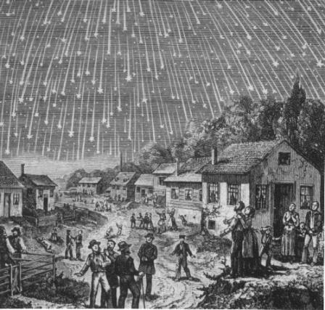
Prophecy Fulfilled
-Matthew 24:29, Revelation 6:13
-The Stars fell on November 13, 1833
- “Never did rain fall thinker than the meteors fell toward the earth.”

Slide 31
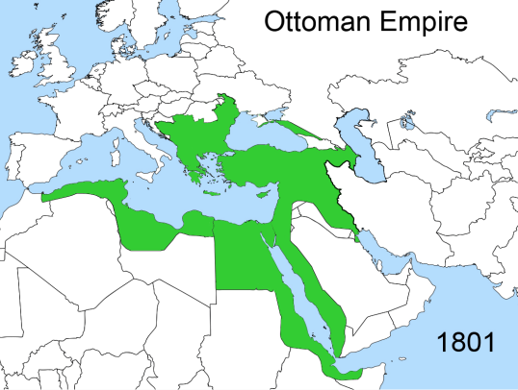
Prophecy Fulfilled
-Josiah Litch
-Predicted Ottoman Empire would fall on August 11, 1840
-Published this on Aug. 11, 1840
-Revelation 9 (vs. 15)

Slide 32
Setting Dates
May 21, 1843 –
May 21, 1844

Slide 33
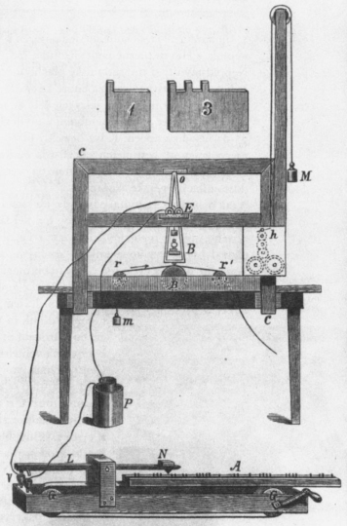
Setting Dates
-1st Telegraph Message
-May 24, 1844
-Samuel Morse
-“What God hath Wrought”

Slide 34
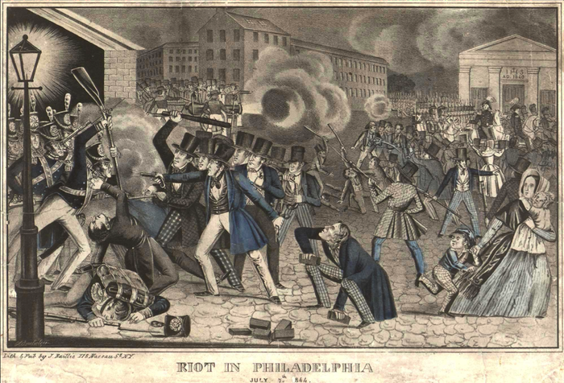
Setting Dates
-Riot in Philadelphia
-May 6-8
-July 6-7
-1844
-Anti-Catholic/Irish

Slide 35
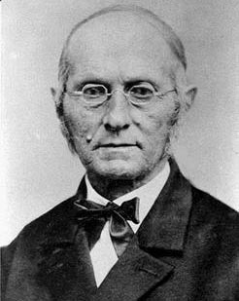
Setting Dates
-Exeter Campmeeting
-August 15, 1844
-Joseph Bates

Slide 36
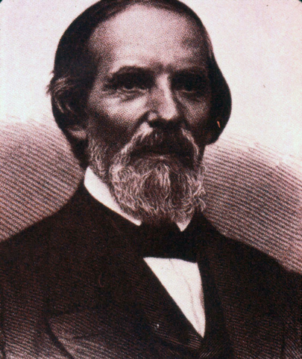
The Midnight Cry!
-Samuel S. Snow
-New Date: October 22, 1844

Slide 37
The Midnight Cry!
“Like a tidal wave the movement swept over the land. From city to city, from village to village, and into remote country places it went, until the waiting people of God were fully aroused. Before this proclamation, fanaticism disappeared, like early frost before the rising sun. Believers once more found their position, and hope and courage animated their hearts. The work was free from those extremes which are ever manifested when there is human excitement without the controlling influence of the word and Spirit of God…There was little ecstatic joy, but rather deep searching of heart, confession of sin, and forsaking of the world. A preparation to meet the Lord was the burden of agonizing spirits. There was persevering prayer, and unreserved consecration to God.”
- Spirit of Prophecy vol. 4, p.249 -

Slide 38
The Midnight Cry!

Slide 39
The Great Disappointment
October 22, 1844

Slide 40
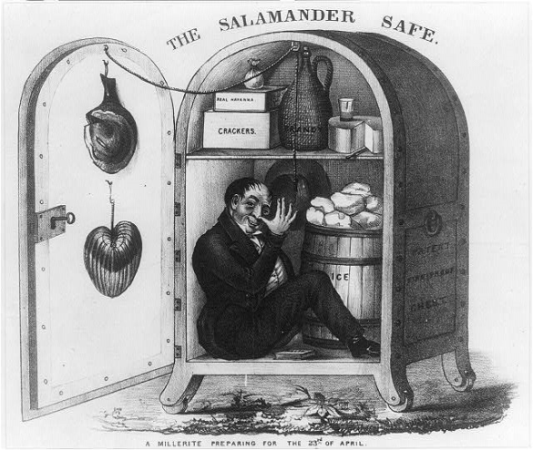
The Great Disappointment…

Slide 41
The Great Disappointment…

Slide 42
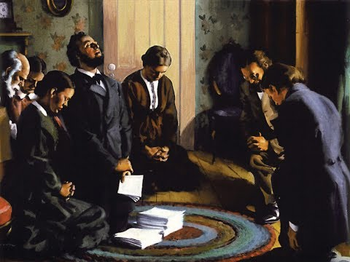
The Great Disappointment…

Slide 43
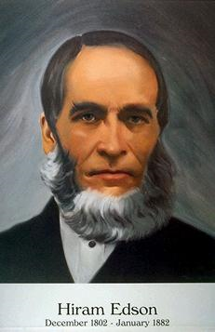
Hiram Edson
"Our fondest hopes and expectations were blasted, and such a spirit of weeping came over us as I never experienced before. It seemed that the loss of all earthly friends could have been no comparison. We wept, and wept, till the day dawn."

Slide 44
Loughborough John Norton
BITTER DISAPPOINTMENT
"The disappointment at the passing of the time 183
was a bitter one. True believers had given up all for Christ, and had shared His presence as never before. They had, as they supposed, given their last warning to the world, and had separated themselves, more or less, from the unbelieving, scoffing, multitude. And, with the divine blessing upon them, they felt more like associating with their soon expected Master and the holy angels than with those from whom they had separated themselves. The love of Jesus filled every soul and beamed from every face, and with inexpressible desires they prayed, 'Come, Lord Jesus, and come quickly.' But He did not come. And now, to turn again to the cares, perplexities, and dangers of life, in full view of the jeers and revilings of unbelievers, who now scoffed as never before, was a terrible trial of faith and patience. When Elder Himes visited Portland, Me., a few days after the passing of the time, and stated that the brethren should prepare for another cold winter, my feelings were almost uncontrollable. I left the place of meeting and wept like a child." 2 {1904 JNL, LDT 182.4}

Slide 45
Damsteegt Pieter Gerard
The second or great disappointment
Shortly before the expected event nearly all Millerites participated in the proclamation of the True Midnight Cry of the Seventh Month movement, and it was stated that "the time has been almost universally received by all the Adventists." 1 Miller anticipated that probationary time for mankind would terminate a few days before October 22, stating, "I am strong in my opinion that the next [October 13] will be the last Lord's day sinners will ever have in probation and within ten or fifteen days from thence, they will see him, whom they have hated and despised." 2 On the 16th of October, the editors of the Advent Herald expressed the following sentiments: {1977 PGD, FSDA 99.1}
We feel that we have arrived at a most solemn and momentous crisis; and from the light we have, we are shut up to the conviction that the tenth day of the seventh month must usher in the glorious appearing of the great God and our Savior Jesus Christ. We therefore feel that our work is now finished, and that all we have to do is to go out to meet the Bridegroom, and to trim our lamps accordingly. . . . Now we feel that our controversies are all over, that the battle has been fought, and our warfare ended. And now we wish to humble ourselves under the mighty hand of God that we may be accepted at his coming. 3 {1977 PGD, FSDA 99.2}
When Tuesday, October 22, passed, the Millerites experienced a very great disappointment that could be best described by those who experienced it. Hiram Edson, a Millerite with Methodist background, said: {1977 PGD, FSDA 99.3}
Our expectations were raised high, and thus we looked for our coming Lord until the clock tolled 12 at midnight. The day had then passed and our disappointment became a certainty. Our fondest hopes and expectations were blasted, and such a spirit of weeping came over us as I never experienced before. It seemed that the loss of all earthly friends could have been no comparison. We wept, and wept, till the day dawn. I mused in my own heart, saying, My advent experience has been the richest and brightest of all my Christian experiences. If this had proved a failure, what was the rest of my Christian experience worth? Has the Bible proved a failure? Is there no God, no heaven, no golden home city, no paradise? Is all this but a cunningly devised fable? Is there no reality to our fondest hope and expectation of these things? And thus we had something to grieve and weep over, if all our fond hopes were lost. 4 {1977 PGD, FSDA 99.4}

Slide 46
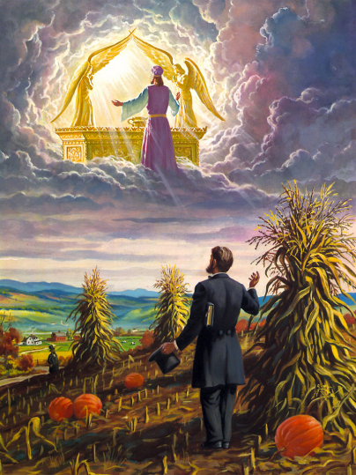
Hiram Edson

Slide 47
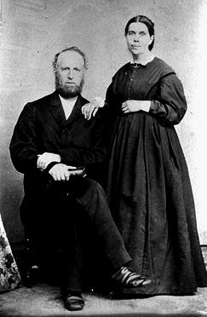
The Movement Continues

Slide 48
Questions
Why did God allow William Miller to make such a mistake?

Slide 49
Answers
“God accomplished His own beneficent purpose in permitting the warning of the judgment to be given just as it was. The great day was at hand, and in His providence the people were brought to the test of a definite time, in order to reveal to them what was in their hearts. The message was designed for the testing and purification of the church. They were to be led to see whether their affections were set upon his world or upon Christ in heaven…

Slide 50
Answers
“…They professed to love the Saviour; now they were to prove their love. Were they ready to renounce their worldly hopes and ambitions, and welcome with joy the advent of their Lord? The message was designed to enable them to discern their true spiritual state; it was sent in mercy to arouse them to seek the Lord with repentance and humiliation.”
-The Great Controversy, p. 353.1

Slide 52
BLESSINGS

