Slide 1
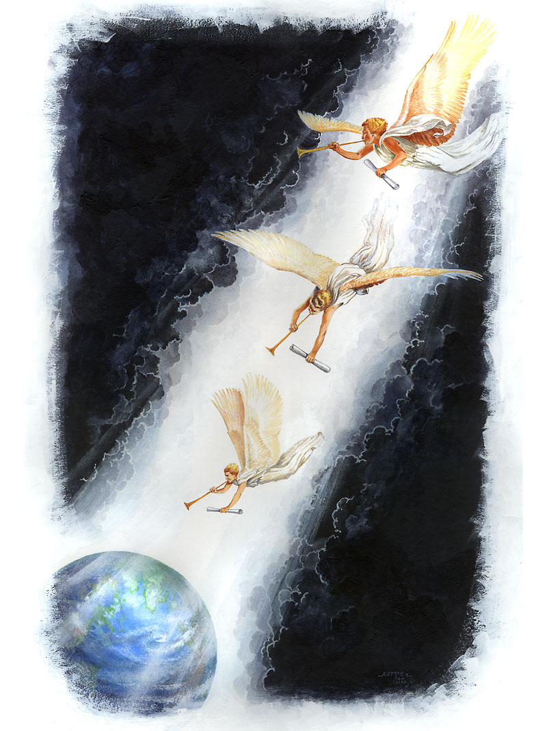
BROKEN BLUEPRINT

Slide 2
HOW MANY FAMILIES WILL PERFECT CHARACTER WHILE LIVING IN THE CITIES
There is NOT one family in a hundred who will be improved physically, mentally, or spiritually by residing in the city. Faith, hope, love, happiness, can far better be gained in retired places, where there are fields and hills and trees. Take your children away from the sights and sounds of the city, away from the rattle and din of streetcars and teams, and their minds will become more healthy. It will be found easier to bring home to their hearts the truth of the word of God. {AH 137.2}

Slide 3
JOB 28:28: And unto man he said, Behold, the fear of the Lord, that [is] wisdom; and to depart from evil [is] understanding.

Slide 4
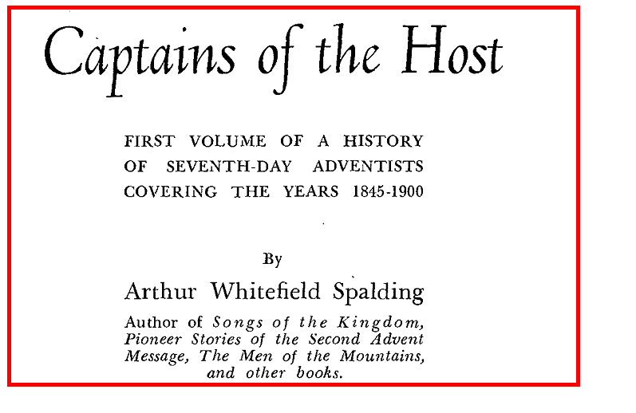

Slide 5
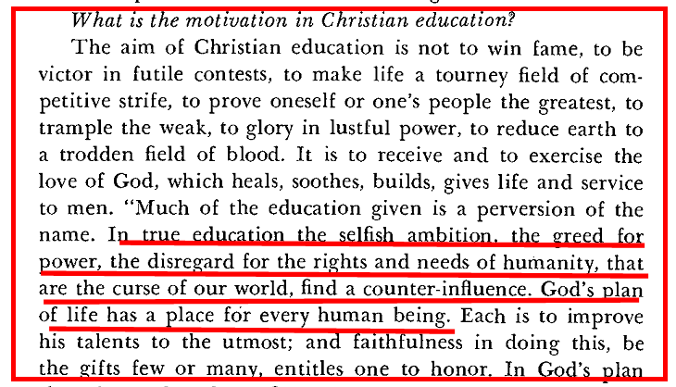

Slide 7
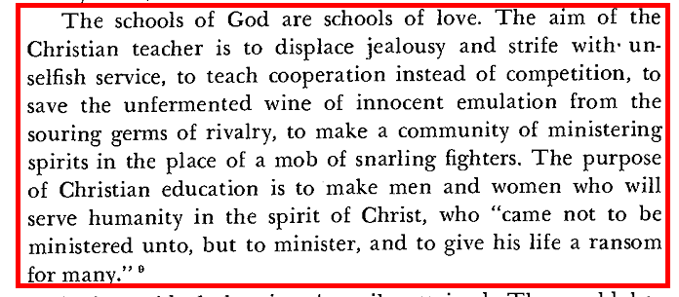

Slide 9
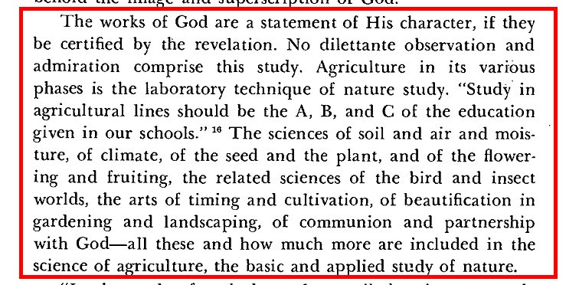

Slide 10
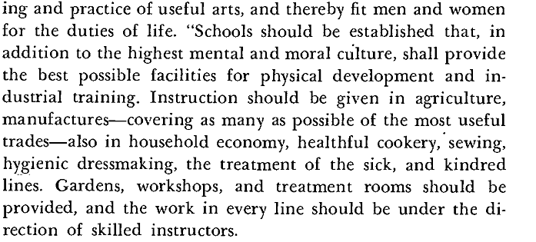

Slide 11
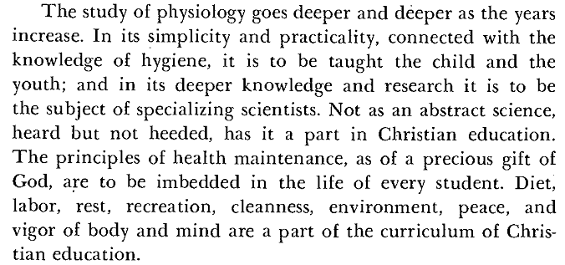

Slide 12
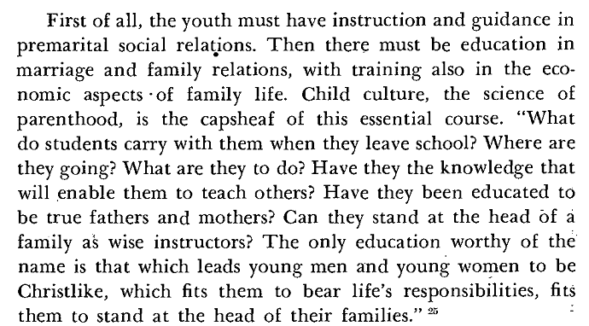

Slide 13
…..The church that holds to the word of God is irreconcilably separated from Rome….. Rome never changes. Her principles have not altered in the least. She has not lessened the breach between herself and Protestants; they have done all the advancing……It is the rejection of Bible truth which makes men approach to infidelity. It is a backsliding church that lessens the distance between itself and the Papacy. {ST, February 19, 1894 par. 4}

Slide 14
But Romanism as a system is no more in harmony with the gospel of Christ now than at any former period in her history. The Protestant churches are in great darkness, or they would discern the signs of the times. The Roman Church is far-reaching in her plans and modes of operation. She is employing every device to extend her influence and increase her power in preparation for a fierce and determined conflict to regain control of the world, to re-establish persecution, and to undo all that Protestantism has done. Catholicism is gaining ground upon every side. See the increasing number of her churches and chapels in Protestant countries. Look at the popularity of her colleges and seminaries in America, so widely patronized by Protestants. Look at the growth of ritualism in England and the frequent defections to the ranks of the Catholics. These things should awaken the anxiety of all who prize the pure principles of the gospel. {GC 565.4}

Slide 15
The time was when Protestants placed a high value upon the liberty of conscience which had been so dearly purchased. They taught their children to abhor popery and held that to seek harmony with Rome would be disloyalty to God. But how widely different are the sentiments now expressed! {GC 563}

Slide 16
Protestants have tampered with and patronized popery; they have made compromises and concessions which papists themselves are surprised to see and fail to understand. Men are closing their eyes to the real character of Romanism(Popery) and the dangers to be apprehended from her supremacy. The people need to be aroused to resist the advances of this most dangerous foe to civil and religious liberty. {GC 566.}

Slide 17
METHODS EMPLOYED BY JESUITS TO EXTINGUISH PROTESTANTISM

Slide 18
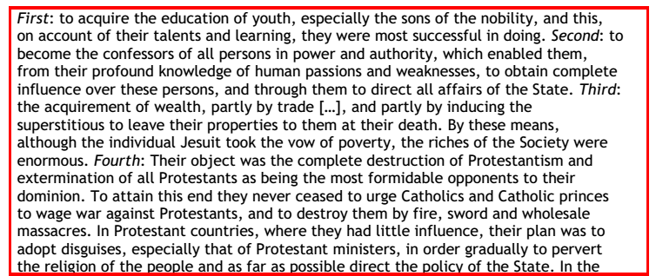

Slide 22
Parents should be the only teachers of their children until they have reached eight or ten years of age. As fast as their minds can comprehend it, the parents should open before them God's great book of nature. The mother should have less love for the artificial in her house, and in the preparation of her dress for display, and should find time to cultivate, in herself and in her children, a love for the beautiful buds and opening flowers. {CE 9 }

Slide 23
Students that exalt the sciences above the God of science, will be ignorant when they think themselves very wise. If you cannot afford time to pray, cannot give time for communion with God, for self-examination, and do not appreciate that wisdom which comes alone from God all your learning will be deficient, and your schools and colleges will be found wanting. 96 {CSA 65.3}

Slide 24
GRADING HAS NEVER BEEN GOD’S METHOD!!
The specific place appointed us in life is determined by our capabilities. Not all reach the same development or do with equal efficiency the same work. God does not expect the hyssop to attain the proportions of the cedar, or the olive the height of the stately palm. But each should aim just as high as the union of human with divine power makes it possible for him to reach. 97 {CSA 65.4}

Slide 25
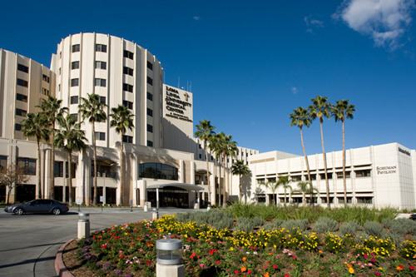
From Sanitariums
To Hospitals
FROM GOD’S WAY TO MAN’S WAY
The purpose of our health institutions is not first and foremost to be that of hospitals. The health institutions connected
with the closing work of the gospel in the earth stand for the great principles of the gospel in all its fullness. Christ is the one to be revealed in all the institutions connected with the closing work, but none of them can do it so fully as the health institution where the sick and suffering come for relief and deliverance from both physical and spiritual ailment. Many of these need, like the paralytic of old, the forgiveness of sin the first thing, and they need to learn how to "go, and sin no more." {MM 27.4}
If a sanitarium connected with this closing message fails to lift up Christ and the principles of the gospel as developed in the third angel's message, it fails in its most important feature, and contradicts the very object of its existence.--R.H., Oct. 29, 1914. {MM 28.1}
LOMA LINDA HOSPITAL

Slide 26
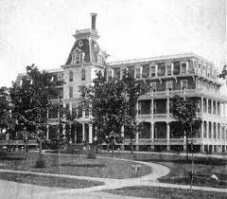
There are many ways of practicing the healing art; but there is only one way that Heaven approves. God's remedies are the simple agencies of nature, that will not tax or debilitate the system through their powerful properties. Pure air and water, cleanliness, a proper diet, purity of life, and a firm trust in God, are remedies for the want of which thousands are dying;
SANITARIUM
HOSPITAL
DRUG THERAPY
yet these remedies are going out of date because their skillful use requires work that the people do not appreciate. Fresh air, exercise, pure water, and clean, sweet premises, are within the reach of all, with but little expense; but drugs are expensive, both in the outlay of means, and the effect produced upon the system. {CD 301.2}

Slide 27
JOB 28:12-17 But where shall wisdom be found? and where [is] the place of understanding? Man knoweth not the price thereof; neither is it found in the land of the living. The depth saith, It [is] not in me: and the sea saith, [It is] not with me. It cannot be gotten for gold, neither shall silver be weighed [for] the price thereof.
It cannot be valued with the gold of Ophir, with the precious onyx, or the sapphire. The gold and the crystal cannot equal it: and the exchange of it [shall not be for] jewels of fine gold.

Slide 28
YOU CAN’T ENTUST THE WORLD WITH YOUR CHILD
Parents will never arouse to their responsibility of bringing their children up with correct habits, until they are wholly converted to God's way and will, as was Abraham. Of him God said: "I know him, that he will command his children and his household after him, and they shall keep the way of the Lord, to do justice and judgment, that the Lord may bring upon Abraham that which He has spoken of him." God's rich promises to Abraham in regard to his posterity were made on condition that Abraham co-operated with Him in the education and training of his household and children. If Abraham chose his own way, following his own impulses, indulging blind affection, the child of promise would develop a character that would not bring honor to God's name, and God would not be able to use him to carry out His will and way. {ST, August 23, 1899 par. 11}

Slide 29
CHRIST HOME SCHOOLED
Jesus secured His education in the home. His mother was His first human teacher. From her lips, and from the scrolls of the prophets, He learned of heavenly things. He lived in a peasant's home and faithfully and cheerfully acted His part in bearing the household burdens. He who had been the commander of heaven was a willing servant, a loving, obedient son. He learned a trade, and with His own hands worked in the carpenter's shop with Joseph. {CG 19.4}

Slide 30
PARENTS MUST WAKE UP
The work of parents, which means so much, is greatly neglected. Awake, parents, from your spiritual slumber and understand that the very first teaching the child receives is to be given to him by you. You are to teach your little ones to know Christ. This work you must do before Satan sows his seeds in their hearts. Christ calls the children, and they are to be led to Him, educated in habits of, neatness, and order. This is the discipline Christ desires them to receive. {CG 23.4}
Sin will lie at the door of parents unless they take themselves in hand and qualify themselves to become wise, safe, Christian teachers. {CG 24.1}

Slide 31
SPENDING MONEY FOR CHAFF
I must tell you from the light given me by God, I know that much time and money are spent by students in acquiring a knowledge that is as chaff to them; for it does not enable them to help their fellow-men to form characters that will fit them to unite with saints and angels in the higher school. In the place of crowding youthful minds with a mass of things that are distasteful, and that in many cases will never be of any use to them, a practical education should be given. Time and money is spent in gaining useless knowledge. The mind should be carefully and wisely taught to dwell upon Bible truth. The main object of education should be to gain a knowledge of how we can glorify God, whose we are by creation and by redemption. {SpM 56.2}

Slide 32
EDUCATION MEANS ETERNITY
Now, as never before, we need to understand the true science of education. If we fail to understand this, we shall never have a place in the kingdom of God. "This is life eternal, that they might know thee the only true God, and Jesus Christ whom thou has sent." If this is the price of heaven, shall not our education be given on these lines? Christ must be everything to us. "Unto us a child is born, unto us a son is given; and the government shall be upon his shoulders and his name shall be called Wonderful, Counsellor, The mighty God, The everlasting Father, the Prince of peace." What foundation is here laid for the faith of those who shall live in all ages!.......{SpM 56.4}
This is the great subject that underlies all true, sanctified education. When this is made the theme of our conversation, no idle common talk will fall from our lips. Jesting and joking are heard because the soul-temple is unsanctified and unholy. {SpM 57.1}

Slide 33
GREAT SUBJECT OF STUDY
In every school established the most simple theory of theology should be taught. In this theory, the atonement of Christ should be the great substance, the central truth. The wonderful theme of redemption should be presented to the students.--Manuscript 156, 1898

Slide 34
NO TRIFFLING
In this lower school of earth we are to learn the lessons that will prepare us to enter the higher school, where our education will continue under the personal instruction of Christ. Then he will open to us the meaning of his word. Shall we not, in the few days of probation remaining to us, act like men and women who are seeking for life in the kingdom of God, even an eternity of bliss? We can not afford to miss the privilege of seeing Christ face to face, and of hearing from his lips the story of redemption. Shall we put our whole souls into the work of preparing for admission into the higher school, or shall we trifle away the gracious opportunity, wasting the months and years so rapidly passing into eternity?

Slide 35
EDUCATION AND PROBATION
We would not depreciate education in the least, but would counsel that it be carried forward with a full sense of the shortness of time, and the great work that is to be accomplished before the coming of Christ. We would not have the students receive the idea that they can spend many years in acquiring an education. Let them use the education that they can acquire in a reasonable length of time, in carrying forward the work of God. Our Saviour is in the sanctuary pleading in our behalf. He is our interceding High Priest, making an atoning sacrifice for us, pleading in our behalf the efficacy of His blood. Parents should seek to represent this Saviour to their children to establish in their minds the plan of salvation, how that because of transgression of the law of God, Christ became our sin-bearer. The fact that the only-begotten Son of God gave His life because of man's transgression, to satisfy justice and to vindicate the honor of God's law, should be constantly kept before the minds of children and youth. (FE 370,371)

Slide 36
Many think that they must consult commentaries on the Scriptures in order to understand the meaning of the word of God, and we would not take the position that commentaries should not be studied; but it will take much discernment to discover the truth of God under the mass of the words of men. How little has been done by the church as a body professing to believe the Bible, to gather up the scattered jewels of God's word into one perfect chain of truth? The jewels of truth do not lie upon the surface, as many suppose. The master mind in the confederacy of evil is ever at work to keep the truth out of sight, and to bring into full view the opinions of great men. The enemy is doing all in his power to obscure heaven's light through educational processes; for he does not mean that men shall hear the voice of the Lord, saying, "This is the way, walk ye in it." [Isaiah 30:21.] {CE 85.2}

Slide 37
SHAKING
As the storm approaches, a large class who have professed faith in the third angel's message, but have not been sanctified through obedience to the truth, abandon their position, and join the ranks of the opposition. By uniting with the world and partaking of its spirit, they have come to view matters in nearly the same light; and when the test is brought, they are prepared to choose the easy, popular side. Men of talent and pleasing address, who once rejoiced in the truth, employ their powers to deceive and mislead souls. They become the most bitter enemies of their former brethren. When Sabbath-keepers are brought before the courts to answer for their faith, these apostates are the most efficient agents of Satan to misrepresent and accuse them, and by false reports and insinuations to stir up the rulers against them. {GC88 608.1}

Slide 38
UNIVERSITIES:GATES OF HELL
He (LUTHER) wrote thus of the universities: “I fear much that the universities will be found to be great gates leading down to hell, unless they take diligent care to explain the Holy Scriptures, and to engrave them in the hearts of our youth. I advise no one to place his child where the Holy Scriptures are not regarded as the rule of life. Every institution where the Word of God is not diligently studied, must become corrupt.” {GC88 140.4}

Slide 39
That which had been shown me as a place where the suffering sick among us could be helped was one where sacrifice, hospitality, faith, and piety should be the ruling principles. But when unqualified calls were made for large sums of money, with the statement that stock taken would pay large per cent; when the brethren who occupied positions in the institution seemed more than willing to take larger wages than those were satisfied with who filled other and equally important stations in the great cause of truth and reform; when I learned, with pain, that, in order to make the institution popular with those not of our faith and to secure their patronage, a spirit of compromise was rapidly gaining ground at the Institute, manifested in the use of Mr., Miss, and Mrs., instead of Brother and Sister, and in popular amusements, in which all could engage in a sort of comparatively innocent frolic--when I saw these things, I said: This is not that which was shown me as an institution for the sick which would share the signal blessing of God. This is another thing. {1T 633.2}

Slide 40
THAT WE MAY BE LIKE ALL THE NATIONS
All routes lead to Rome

Slide 41
That God who knows their spiritual condition declares: They have cherished evil and separated from Me. They have gone astray, every one of them. Not one is guiltless. They have forsaken Me, the Fountain of living waters, and have hewed out to them broken cisterns that can hold no water. Many have corrupted their ways before Me. Envy, hatred of one another, jealousy, evil surmising, emulation, strife, bitterness, is the fruit that they bear. And they will not heed the testimony that I send them. They will not see their perverse ways and be converted, that I should heal them. {5T 63.2}

Slide 42
I am filled with pain and anguish as I see parents conforming to the world and allowing their children to meet the worldly standard at such a time as this. I am filled with horror as the condition of families professing present truth is opened before me. The profligacy of youth and even children is almost incredible. Parents do not know that secret vice is destroying and defacing the image of God in their children. The sins which characterized the Sodomites exist among them. The parents are responsible; for they have not educated their children to love and obey God. They have not restrained them nor diligently taught them the way of the Lord. They have allowed them to go out and to come in when they chose, and to associate with worldlings. These worldly influences which counteract parental teaching and authority are to be found largely in so-called good society. By their dress, looks, amusements, they surround themselves with an atmosphere which is opposed to Christ. {5T 78.1}

Slide 43
Many have exalted science and lost sight of the God of science. This was not the case with the church in the purest times. God will work a work in our day that but few anticipate. He will raise up and exalt among us those who are taught rather by the unction of His Spirit than by the outward training of scientific institutions. These facilities are not to be despised or condemned; they are ordained of God, but they can furnish only the exterior qualifications. God will manifest that He is not dependent on learned, self-important mortals. {5T 82.4}

Slide 44
A CRY FROM THE CHURCH : “APPOINT US AKING THAT WE MAY BE JUST LIKE THE OTHER NATIONS”
ACCREDITATION
LOMA LINDA
BATTLE CREEK
WALA WALA
EMMANUEL MISSIONARY COLLAGE
MADISON

Slide 45
In 1903, A.T. Jones was planning to go to Battle Creek to help Dr. J.H. Kellogg reopen Battle Creek College and have it conform to requirement standards set by the AMA. Before departing California for Michigan, Jones stopped by Elmshaven and Ellen White pled with him. She told him we do not want the stamp—the imprint—of the accrediting agencies on our people.
“Get out of Battle Creek; for Heaven’s sake get out of Battle Creek! . . All this reaching up toward a worldly standard is unnecessary. When Christ came into the world as our teacher, He chose unlearned men as His disciples . . [Do not go there] . . Let them raise a standard and require a degree . . He [Christ] would rather work for fishermen than learned men who knew so much . . They are not fitted for our work . . We do not need the commendation of those that do not know what true education is. We do not want their stamp. God is going to give us His Holy Spirit to enlighten our understanding.”—EGW, August 15, 1903.

Slide 46
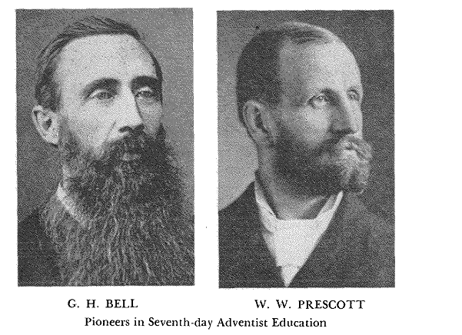

Slide 47
Our people are now being tested as to whether they will obtain their wisdom from the greatest Teacher the world ever knew, or seek to the god of Ekron. Let us determine that we will not be tied by so much as a thread to the educational policies of those who do not discern the voice of God and who will not hearken to His commandments. {CT 255.4}

Slide 48
TRACING THE EDUCATION OF WATCHMEN
ENOCH
ABRAHAM
JOSEPH
MOSES
ELIJAH
JEREMIAH
DANIEL
JOHN THE BAPTIST
CHRIST JESUS
THE REMNANT CHURCH – SISTER ELLEN G WHITE

Slide 49
1 COR 1:27-29:”But God hath chosen the foolish things of the world to confound the wise; and God hath chosen the weak things of the world to confound the things which are mighty; And base things of the world, and things which are despised, hath God chosen, [yea], and things which are not, to bring to nought things that are: That no flesh should glory in his presence.”

Slide 50
WELL WHAT OF OUR TITLES?
That which had been shown me as a place where the suffering sick among us could be helped was one where sacrifice, hospitality, faith, and piety should be the ruling principles. But when unqualified calls were made for large sums of money, with the statement that stock taken would pay large per cent…..; when I learned, with pain, that, in order to make the institution popular with those not of our faith and to secure their patronage, a spirit of compromise was rapidly gaining ground at the Institute, manifested in the use of Mr., Miss, and Mrs., instead of Brother and Sister, and in popular amusements, in which all could engage in a sort of comparatively innocent frolic--when I saw these things, I said: This is not that which was shown me as an institution for the sick which would share the signal blessing of God. This is another thing. {1T 633.2}

Slide 51
“We recommend: 9. That for the sake of maintaining Christian ideals, our college faculties should discourage the use of the title ‘Doctor,’ for this practice has a tendency in the student’s minds to create a kind of educational aristocracy. It would seem that the Lord’s admonition against the use of titles of preferment would apply here.”—1931 Autumn Council Recommendation, Item 9.

Slide 52
“In our schools . . as nowhere else, the employment of the term has a strong educating influence in placing before our youth worldly standards. It makes a distinction between men; it destroys the parity of the teaching brotherhood . . Emphasis on worldly standards and academic distinctions tend to professionalize our schools and dampen the spirit of evangelism.”—F.M. Wilcox, editorial, Review, November 26, 1931.

Slide 53
“Most of the earthly universities of Europe were founded by the pope, and degrees were conferred by his representatives and by virtue of his authority. The custom of awarding degrees spread from Italy to other European states and from Spain, France, and England to the colonies of America. Today degrees are conferred by institutions of learning in all parts of the world . . The title doctor . . was sometimes conferred as an honor by the pope or emperor,and . . after the public exercises had been completed, the chancellor congratulated the candidate and by the authority of the pope awarded the license to teach. The candidate was then invested with the marks of his office. The next sat upon the magisterial chair, a special cap was placed on his head, and he was given a gold ring.”—Encyclopedia of Education, 1971, Vol.3, p. 26.

Slide 54
“Caps, gowns, and degrees are not the best; but they are like feathers in a woman’s bonnet. They will drop off when there is something better to take their place.”—Magan to Sutherland, July 8, 1923.
“In 1898-1899, the college (Emmanuel Missionary College), operating under a new charter, discontinued the granting of cademic degrees. The August issue of the school journal, the Advocate, included a quotation from a Roman Catholic pamphlet: ‘The conferring of degrees was originated by a pope.’ The announcement was made: ‘The College, under its new organization, ceases, with this year to grant degrees. Preparation for usefulness in the cause of Christ will be the subject constantly held before students, replacing the courses and diplomas of the past.’ ”

Slide 55
In 1903, A.T. Jones was planning to go to Battle Creek to help Dr. J.H. Kellogg reopen Battle Creek College and have it conform to requirement standards set by the AMA. Before departing California for Michigan, Jones stopped by Elmshaven and Ellen White pled with him. She told him we do not want the stamp—the imprint—of the accrediting agencies on our people.
“Get out of Battle Creek; for Heaven’s sake get out of Battle Creek! . . All this reaching up toward a worldly standard is unnecessary. When Christ came into the world as our teacher, He chose unlearned men as His disciples . . [Do not go there] . . Let them raise a standard and require a degree . . He [Christ] would rather work for fishermen than learned men who knew so much . . They are not fitted for our work . . We do not need the commendation of those that do not know what true education is. We do not want their stamp. God is going to give us His Holy Spirit to enlighten our understanding.”—EGW, August 15, 1903.

Slide 56
A little over two months later, she wrote Dr. Kellogg another of many letters expressing her deep concern:
“Who will now consecrate themselves to the service of the Lord? Who will now pledge themselves not to affiliate with the world, but to come out from the world and be separate, refusing to pollute the soul with the worldly schemes and practices that have been keeping the church under the enemy’s influence?”—8 Testimonies, p. 45.

Slide 57
"The light has been given me that tremendous pressure will be brought upon every Seventh-day Adventist with whom the world can get into close connection. We need to understand these things. Those who seek the education that the world esteems so highly are gradually led farther and farther from the principles of truth until they become educated worldlings. At what a price have they gained their education! They have parted with the Holy Spirit of God. They have chosen to accept what the world calls knowledge in the place of the truths which God has committed to men through his ministers and prophets and apostles. And there are some who, having secured this worldly education, think that they can introduce it into our schools, but let me tell you that you must not take what the world calls the higher education and bring it into our schools and sanitariums and churches. I speak to you definitely; this must not be done {PH049 11.1}

Slide 58
In 1906, Ellen White wrote a letter to a young man who was inquiring whether he should enter a school of osteopathy:
“It has frequently been seen that what seemed to be favorable opportunities for obtaining an education in worldly institutions were snares of the enemy. The time of the student has been occupied, to the exclusion of the study of God’s Word. They have completed the course of study, but they were not fitted to take up the study of the work of God.”—EGW, September 3, 1906.

