Slide 1
JOHN 17:3 - BEING FILLED WITH HIS GRACE
And this is life eternal, that they might know thee the only true God, and Jesus Christ, whom thou hast sent.

Slide 2
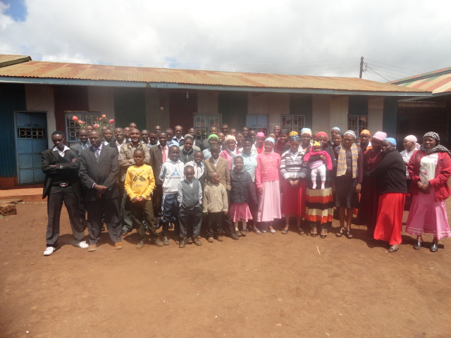
INTRODUCTION
We all have a definite
(clearly defined) opinion
about God’s Character
These opinions affect attitudes (beliefs, feelings, values)
We have all been born with a bent toward a false concept of God

Slide 3
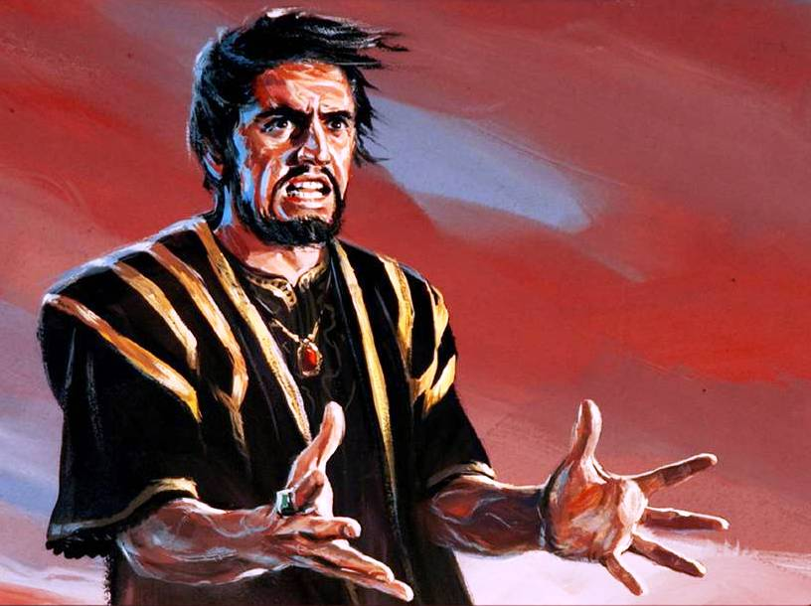
INTRODUCTION
These false conceptions are brought about by Satan
Great Controversy pg 569.1
It is Satan's constant effort to misrepresent the character of God, the nature of sin, and the real issues at stake in the great controversy. His sophistry lessens the obligation of the divine law and gives men license to sin. At the same time he causes them to cherish false conceptions of God so that they regard Him with fear and hate rather than with love.

Slide 4
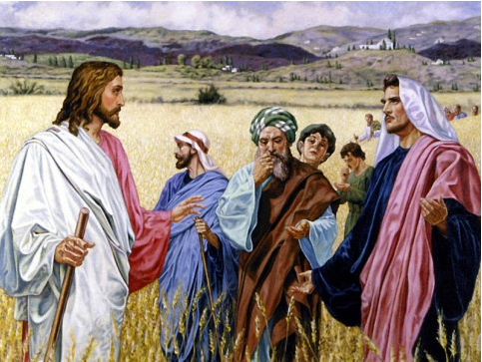
FALSE CONCEPTIONS AT THE TIME OF CHRIST
Desire of Ages pg 299.2
With a feeling...There were scribes and
Pharisees who looked forward to the day
when they should have dominion over the
hated Romans, and possess the riches and
splendor of the world's great empire. The
poor peasants and fishermen hoped to hear the
assurance that their wretched hovels, the scanty food,
the life of toil, and fear of want were to be exchanged for mansions of plenty and days of ease. In place of the one coarse garment which was their covering by day, and their blanket at night, they hoped that Christ would give them the rich and costly robes of their conquerors. All hearts thrilled with the proud hope that Israel was soon to be honored before the nations as the chosen of the Lord, and Jerusalem exalted as the head of a universal kingdom..Christ disappointed the hope of worldly greatness. In the Sermon on the Mount He sought to undo the work that had been wrought by false education, and to give His hearers a right conception of His kingdom and of His own character...

Slide 5
FALSE CONCEPTIONS AT THE TIME OF CHRIST
They wanted to fulfill this
misconception of Christ’s Mission
Desire of Ages pg 377-378
In their enthusiasm the people
are ready at once to crown Him king.
They see that He makes no effort to attract attention or secure honor to Himself. In this He is essentially different from the priests and rulers, and they fear that He will never urge His claim to David's throne. Consulting together, they agree to take Him by force, and proclaim Him the king of Israel. The disciples unite with the multitude in declaring the throne of David the rightful inheritance of their Master.

Slide 6
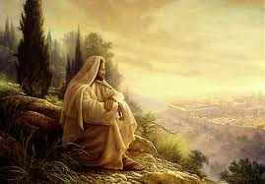
FALSE CONCEPTIONS AT THE TIME OF CHRIST
Christ prayed that for power
to reveal the Divine character of His mission
Desire of Ages
pg 379.1
When left alone, Jesus "went up into a mountain apart to pray." For hours He continued pleading with God. Not for Himself but for men were those prayers. He prayed for power to reveal to men the divine character of His mission, that Satan might not blind their understanding and pervert their judgment.

Slide 7
FALSE CONCEPTIONS AT THE TIME OF CHRIST
Christ prayed that for power to reveal the Divine character of His mission (…Continuation)
What was this mission??
Patriarchs and Prophets pg 68.2
But the plan of redemption had a yet broader and deeper purpose than the salvation of man. It was not for this alone that Christ came to the earth; it was not merely that the inhabitants of this little world might regard the law of God as it should be regarded; but it was to vindicate the character of God before the universe.

Slide 8
FALSE CONCEPTIONS AT THE TIME OF CHRIST
The disciples got doubtful and fell into spiritual darkness
Desire of Ages pg 380.1
Unbelief was taking possession of their minds and hearts. Love of honor had blinded them. They knew that Jesus was hated by the Pharisees, and they were eager to see Him exalted as they thought He should be. To be united with a teacher who could work mighty miracles, and yet to be reviled as deceivers, was a trial they could ill endure. Were they always to be accounted followers of a false prophet? Would Christ never assert His authority as king? Why did not He who possessed such power reveal Himself in His true character, and make their way less painful? Why had He not saved John the Baptist from a violent death? Thus the disciples reasoned until they brought upon themselves great spiritual darkness. They questioned, Could Jesus be an impostor, as the Pharisees asserted?

Slide 9
The character of God is still the most critical issue in the Mission of Christ today

Slide 10
8T 289.2
The knowledge of God as revealed in Christ is the knowledge that all who are saved must have. It is the knowledge that works transformation of character. This knowledge, received, will re-create the soul in the image of God. It will impart to the whole being a spiritual power that is divine. {MH 425.2}

Slide 12
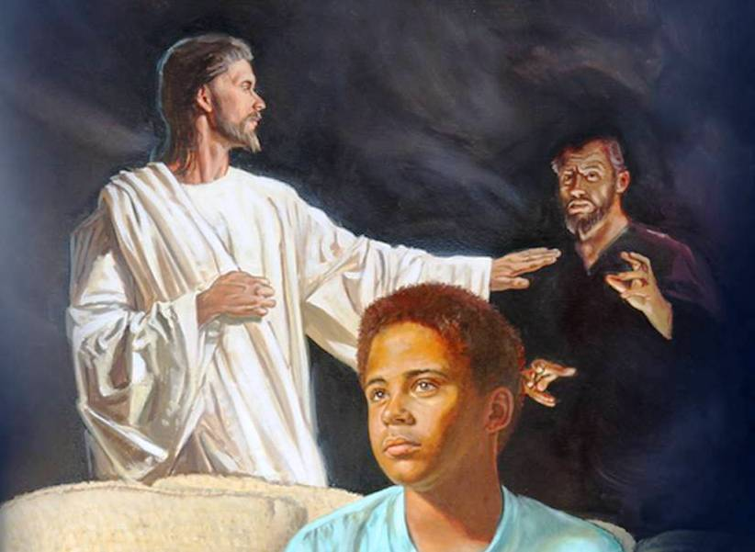
It is the grace of Christ that transforms
Great Controversy pg 506.2
It is the grace that Christ implants in the soul which creates in man enmity against Satan. Without this converting grace and renewing power, man would continue the captive of Satan, a servant ever ready to do his bidding.

Slide 13
This grace is the enlightening of the Holy Spirit
Great Controversy pg 393.4
The latter class had received the grace of God, the regenerating, enlightening power of the Holy Spirit, which renders His word a lamp to the feet and a light to the path.
Hebrews 10:29
Of how much sorer punishment, suppose ye, shall he be thought worthy, who hath trodden under foot the Son of God, and hath counted the blood of the covenant, wherewith he was sanctified, an unholy thing, and hath done despite unto the Spirit of grace?

Slide 14
This grace is the enlightening of the Holy Spirit (…Continuation)
Zechariah 12:10
And I will pour upon the house of David, and upon the inhabitants of Jerusalem, the spirit of grace and of supplications: and they shall look upon me whom they have pierced, and they shall mourn for him, as one mourneth for his only son, and shall be in bitterness for him, as one that is in bitterness for his firstborn.
2 Corinthians 13:14
The grace of the Lord Jesus Christ, and the love of God, and the communion of the Holy Ghost, be with you all. Amen.

Slide 15
This grace is the enlightening of the Holy Spirit (…Continuation)
Selected Messages Vol.1 pg 175.2
When the laborers have an abiding Christ in their own souls, when all selfishness is dead, when there is no rivalry, no strife for the supremacy, when oneness exists, when they sanctify themselves, so that love for one another is seen and felt, then the showers of the grace of the Holy Spirit will just as surely come upon them as that God's promise will never fail in one jot or tittle. But when the work of others is discounted, that the workers may show their own superiority, they prove that their own work does not bear the signature it should. God cannot bless them.--Manuscript 24, 1896.

Slide 16
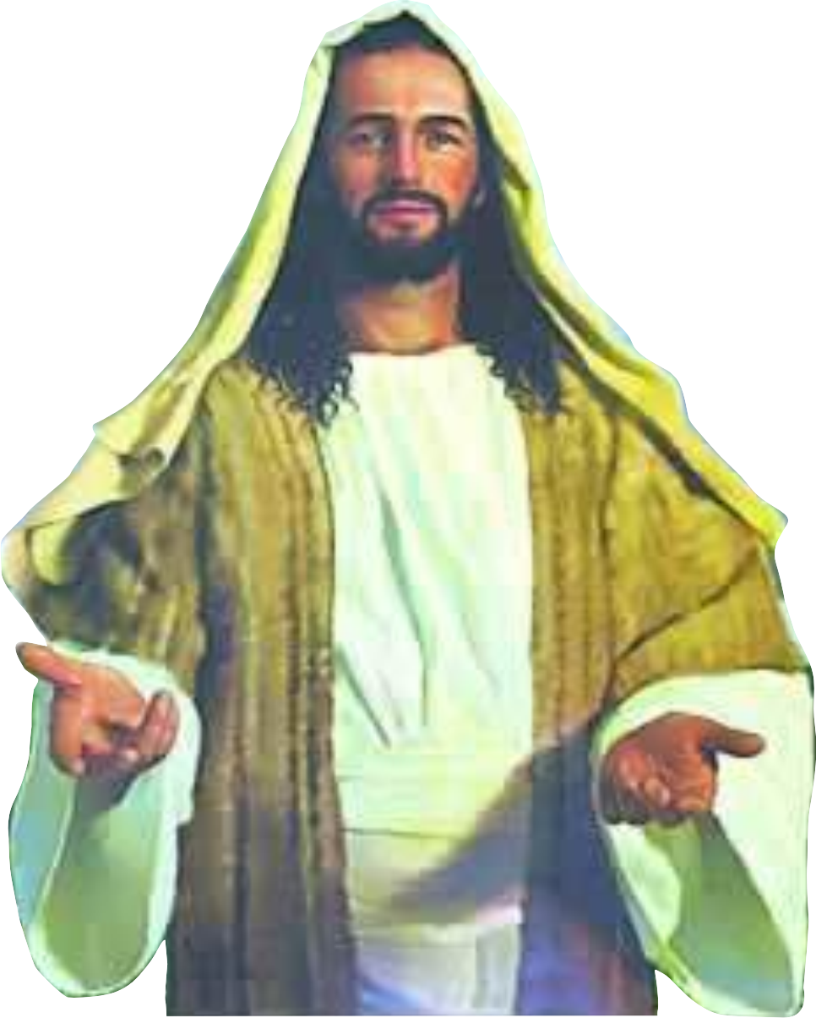
GRACE AND PEACE THROUGH KNOWLEDGE OF GOD AND CHRIST
2 Peter 1:2
Grace and peace be multiplied unto you through the knowledge of God, and of Jesus our Lord
This peace comes from Christ
2 Thessalonians 3:16
Now the Lord of peace Himself
give you peace always by all
means. The Lord be with you all.

Slide 17
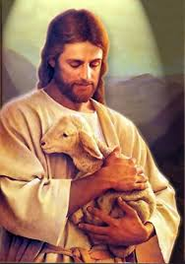
GRACE AND PEACE THROUGH KNOWLEDGE OF GOD AND CHRIST
The Peace of Christ
Ministry of Healing pg 247.1
Abiding peace, true rest of spirit, has
but one Source. It was of this that Christ
spoke when He said, "Come unto Me, all ye that labor and are heavy-laden, and I will give you rest." Matthew 11:28. "Peace I leave with you, My peace I give unto you: not as the world giveth, give I unto you." John 14:27. This peace is not something that He gives apart from Himself. It is in Christ, and we can receive it only by receiving Him.

Slide 18
GRACE AND PEACE THROUGH KNOWLEDGE OF GOD AND CHRIST
The Peace of Christ (…Continuation)
It is only though justification that can we obtain this peace and a knowledge of Christ
Romans 5:1
Therefore being justified by faith, we have peace with God through our Lord Jesus Christ
Faith and Works pg 88.1
The peace of Christ comes through the knowledge of Jesus whom the Bible reveals.

Slide 19
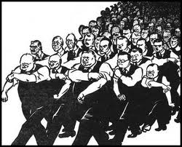
GRACE AND PEACE THROUGH KNOWLEDGE OF GOD AND CHRIST
The opposite of peace is war/enmity
.

Slide 20
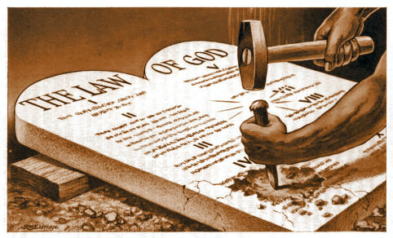
GRACE AND PEACE THROUGH KNOWLEDGE OF GOD AND CHRIST
The opposite of peace is war/enmity
Romans 8:7
Because the carnal mind is enmity against God (not in harmony): for it is not subject to the law of God, neither indeed can be.

Slide 21
GRACE AND PEACE THROUGH KNOWLEDGE OF GOD AND CHRIST
The opposite of peace is war/enmity
5T 743.1
And how can we come into harmony with God, how shall we receive His likeness, unless we obtain a knowledge of Him? It is this knowledge that Christ came into the world to reveal unto us.

Slide 22
WHAT THIS GRACE DOES
Hebrews 4:16
Let us therefore come boldly unto the throne of grace that we may obtain mercy, and find grace to help in time of need.
In all Christ’s parables, He spoke of the kingdom of Grace
Great Controversy pg 346.4
As used in the Bible, the expression "kingdom of God" is employed to designate both the kingdom of grace and the kingdom of glory...The throne of grace represents the kingdom of grace; for the existence of a throne implies the existence of a kingdom. In many of His parables Christ uses the expression "the kingdom of heaven" to designate the work of divine grace upon the hearts of men....The kingdom of grace was instituted immediately after the fall of man, when a plan was devised for the redemption of the guilty race. It then existed in the purpose and by the promise of God; and through faith, men could become its subjects. Yet it was not actually established until the death of Christ...

Slide 23
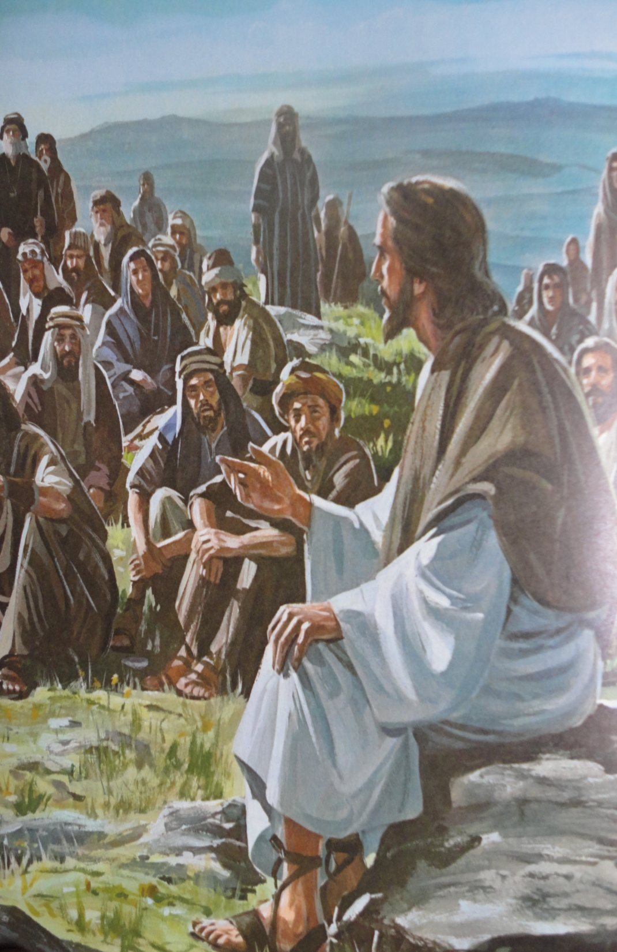
WHAT THIS GRACE DOES
In all Christ’s parables, He spoke of the kingdom of Grace (…Continuation)
Matthew 13:33
Another parable spake He unto them; The kingdom of heaven is like unto leaven, which a woman took, and hid in three measures of meal, till the whole was leavened.

Slide 24
WHAT THIS GRACE DOES
In all Christ’s parables, He spoke of the kingdom of Grace (…Continuation)
Christ Object Lessons pg 96.2
But man cannot transform himself by the exercise of his will. He possesses no power by which this change can be effected. The leaven--something wholly from without--must be put into the meal before the desired change can be wrought in it. So the grace of God must be received by the sinner before he can be fitted for the kingdom of glory...As the leaven, when mingled with the meal, works from within outward, so it is by the renewing of the heart that the grace of God works to transform the life. No mere external change is sufficient to bring us into harmony with God. There are many who try to reform by correcting this or that bad habit, and they hope in this way to become Christians, but they are beginning in the wrong place. Our first work is with the heart.

Slide 25
WHAT THIS GRACE DOES
Proverbs 4:23
Keep thy heart with all diligence; for out of it are the issues of life.

Slide 26
THE MORE WE DRAW NEAR TO CHRIST THE MORE SINFUL WE SEE OURSELVES AND OUR REPENTANCE DEEPENS
Job 42:5-6
I have heard of thee by the hearing of the ear: but now mine eye seeth thee. Wherefore I abhor myself, and repent in dust and ashes.
Acts of the Apostles pg 561.2
So will it be with all who behold Christ. The nearer we come to Jesus, and the more clearly we discern the purity of His character, the more clearly shall we see the exceeding sinfulness of sin, and the less shall we feel like exalting ourselves. There will be a continual reaching out of the soul after God, a continual, earnest, heartbreaking confession of sin and humbling of the heart before Him. At every advance step in our Christian experience our repentance will deepen.

Slide 27
THE MORE WE DRAW NEAR TO CHRIST THE MORE SINFUL WE SEE OURSELVES AND OUR REPENTANCE DEEPENS (…Continuation)
What is repentance??
Steps to Christ pg 23.2
Repentance includes sorrow for sin and a turning away from it. We shall not renounce sin unless we see its sinfulness; until we turn away from it in heart, there will be no real change in the life.

Slide 28
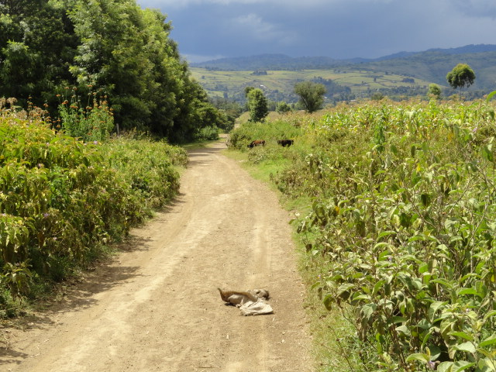
CONCLUSION
5T 740.2
It is Satan's constant study to keep the minds of men occupied with those things which will prevent them from obtaining the knowledge of God.
5T 743.2
The meager views which so many have had of the exalted character and office of Christ have narrowed their religious experience and have greatly hindered their progress in the divine life.
(Meager means=Deficient in amount or quality or extent )

Slide 29
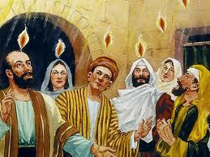
CONCLUSION
The more we know Him, the more we receive the latter rain
Hosea 6:3
Then shall we know, if we follow on to know the LORD: His going forth is prepared as the morning; and He shall come unto us as the rain, as the latter and former rain unto the earth.

Slide 30
CONCLUSION (…Continuation)
Christ Object Lessons pg 415
It is the darkness of misapprehension of God that is enshrouding the world. Men are losing their knowledge of His character. It has been misunderstood and misinterpreted. At this time a message from God is to be proclaimed, a message illuminating in its influence and saving in its power. His character is to be made known. Into the darkness of the world is to be shed the light of His glory, the light of His goodness, mercy, and truth....Those who wait for the Bridegroom's coming are to say to the people, "Behold your God." The last rays of merciful light, the last message of mercy to be given to the world, is a revelation of His character of love. The children of God are to manifest His glory. In their own life and character they are to reveal what the grace of God has done for them

Slide 31
JEREMIAH 3
Notes:
Ideas – Mawazo, range > eneo, course > kozi,
Civilization > hustarabu

Slide 32
According to the Jewish historian Josephus, after Alexander the Great worshiped in the Temple at Jerusalem following his reception by Juddua the high priest, a spirit of friendliness developed between the Greeks and the Jews. Alexander's generals found it difficult to understand why their chief should embrace the high priest when they met on Mount Scopus, instead of putting him to death. Alexander told his officials that what occurred that day was shown to him in a vision when he was in Macedonia, and he wanted the privilege of entering the Temple and worshiping the God of Juddua (Josephus, Antiquities of the Jews 11. 8. 5).
Notes:
Ideas – Mawazo, range > eneo, course > kozi,
Civilization > hustarabu

Slide 33
The Greeks assured the Jews that they desired to be their true friends and benefactors. They desired to learn more of the God of the Hebrews. An arrangement was entered into that allowed a large number of rabbis from Jerusalem to go to Alexandria in Egypt and translate the writings of the Jewish Scriptures into the Greek language. Greek scholarship and learning was seeking in every way possible to enhance the value of its own culture and refinement. It was also suggested by the Greeks that the Jews send their talented young men to Alexandria for training and instruction in the philosophies, sciences, and learning of the Greeks.
Notes:
Ideas – Mawazo, range > eneo, course > kozi,
Civilization > hustarabu

Slide 34
Many of the elders of Israel feared the results of such a course, the sages remembering the sorrows of their ancestors who came into contact with heathen manners and customs. They counseled the younger men against such a procedure. These, in turn, argued that it would be an advantage for strong, thoughtful, vigorous young men to enter the schools of Greece, as they might influence the philosophers and Greek scholars to see the value and beauty of the Jewish religion, and some of the learned Greeks might embrace Judaism. Still, the aged men of Israel advised against it. They maintained that should the younger men come into contact with the learning of the heathen, it might be ruinous to the future of the Jewish race
Notes:
Ideas – Mawazo, range > eneo, course > kozi,
Civilization > hustarabu

Slide 35
The Greeks assured the fathers in Israel that they could hold to their own standards of religion. They were encouraged to believe that the synagogues where the children were taught their religion would not be interfered with; their Beth Hamedrosh (house of learning, their high schools), where their young people received preparatory training, would continue as heretofore; the Talmud Torah (their colleges where advanced studies were conducted) would be strengthened if the teachers of the law could draw from the wisdom and learning of the scholars of Greece; and by receiving recognition from Greece, at that time the world's greatest nation, the graduates of Jewish schools would be greatly advantaged.
Notes:
Ideas – Mawazo, range > eneo, course > kozi,
Civilization > hustarabu

Slide 36
Many of Israel's influential men yielded to Greek urging. They said that God would help their young men to be true to their religion, and the training schools of Jewry would have a better standing in the eyes of the nations. The men of Israel were made to feel that the advantages of the Jewish scholars would be immeasurable. The young men would gain knowledge, influence, prestige.
Notes:
Ideas – Mawazo, range > eneo, course > kozi,
Civilization > hustarabu

Slide 37
Gradually the Jewish schools came to confer degrees upon their graduates. There were the Rav, or rabbi, the Tana, the Gayon, the Sadi, and the Rabbon. It was thought necessary for the graduates of the rabbinical schools to display their rank by wearing different clothing. Little by little an educational aristocracy was formed, which was called the Sanhedrin. This term is of Greek origin, the Hebrew name being Beth din ha-go-dol, Great House of Judgment.
Notes:
Ideas – Mawazo, range > eneo, course > kozi,
Civilization > hustarabu

Slide 38
The religious schools continued to operate, but a marked declension in spiritual influence and power was apparent. Year by year the word of God was studied less, as studies based on culture and philosophy increased. Human concerns became exalted and God was less thought of. The rabbi was extolled; the unlearned were depreciated. Piety gradually diminished as form and ceremony increased. Many laws were passed favoring rabbinism and school customs, yet students were encouraged to love and obey God.
Notes:
Ideas – Mawazo, range > eneo, course > kozi,
Civilization > hustarabu

Slide 39
In Ethics of the Fathers the rabbis taught "A child of five years should study the Bible, at ten the Mishna, at fifteen the Gemara."
The Mishna is a voluminous commentary on the Bible; the Gemara is the commentary of the Mishna. So as the student advanced in years and developed in mental acumen, he studied God's word less and human writings more.
Notes:
Ideas – Mawazo, range > eneo, course > kozi,
Civilization > hustarabu

Slide 40
In order for leaders to be accepted by Jewish assemblies, they must have completed a course in the rabbinical schools. Those who failed to follow the procedure mapped out by the Great Sanhedrin (or by the lesser Sanhedrin located in cities and towns of Palestine outside Jerusalem, headquarters of the Beth din ha-go-dol, The Great House of Judgment) received no recognition by the populace. The graduate rabbi was known by his garb. It was imperative that rabbinical qualifications be met in order for a person to gain a hearing by the children of Abraham
Notes:
Ideas – Mawazo, range > eneo, course > kozi,
Civilization > hustarabu

Slide 41
Such were conditions in the land of Judea at the time John and Jesus appeared.
"By the Babylonish captivity the Israelites were effectually cured of the worship of graven images. During the centuries that followed, they suffered from the oppression of heathen foes until the conviction became fixed that their prosperity depended upon their obedience to the law of God . . . After the return from Babylon, much attention was given to religious instruction. All over the country, synagogues were erected where the law was expounded by the priests and scribes. And schools were established, which, together with the arts and sciences, professed to teach the principles of righteousness. But these agencies became corrupted . . . In many things they conformed to the practices of idolaters.
Notes:
Ideas – Mawazo, range > eneo, course > kozi,
Civilization > hustarabu

Slide 42
"As they departed from God, the Jews in a great degree lost sight of the teaching of the ritual service . . . The Jews lost the spiritual life from their ceremonies, and clung to the dead forms . . . In order to supply the place of that which they had lost, the priests and rabbis multiplied requirements of their own; and the more rigid they grew, the less of the love of God was manifested. They measured their holiness by the multitude of their ceremonies, while their hearts were filled with pride and hypocrisy."-- The Desire of Ages, 29
Notes:
Ideas – Mawazo, range > eneo, course > kozi,
Civilization > hustarabu

Slide 43
ACTS 3
Matthew 28:18
Psalms 116:10
Notes:
Ideas – Mawazo, range > eneo, course > kozi,
Civilization > hustarabu

Slide 44
WORSHIPING AT SATAN’S THRONE
End of the 2300 Days
I saw a throne, and on it sat the Father and the Son. I gazed on Jesus' countenance and admired His lovely person. The Father's person I could not behold, for a cloud of glorious light covered Him. I asked Jesus if His Father had a form like Himself. He said He had, but I could not behold it, for said He, "If you should once behold the glory of His person, you would cease to exist." Before the throne I saw the Advent people--the church and the world. I saw two companies, one bowed down before the throne, deeply interested, while the other stood uninterested and careless. Those who were bowed before the throne would offer up their prayers and look to Jesus; then He would look to His Father, and appear to be pleading with Him. A light would come from the Father to the Son and from the Son to the praying company. Then I saw an exceeding bright light come from the Father to the Son, and from the Son it waved over the people before the throne. But few would receive this great light. Many came out from under it and immediately resisted it; others were careless and did not cherish the light, and it moved off from them. Some cherished it, and went and bowed down with the little praying company. This company all received the light and rejoiced in it, and their countenances shone with its glory. {EW 54.2}
I saw the Father rise from the throne, [SEE PAGE 92.] and in a flaming chariot go into the holy of holies within the veil, and sit down. Then Jesus rose up from the throne, and the most of those who were bowed down arose with Him. I did not see one ray of light pass from Jesus to the careless multitude after He arose, and they were left in perfect darkness. Those who arose when Jesus did, kept their eyes fixed on Him as He left the throne and led them out a little way. Then He raised His right arm, and we heard His lovely voice saying, "Wait here; I am going to My Father to receive the kingdom; keep your garments spotless, and in a little while I will return from the wedding and receive you to Myself." Then a cloudy chariot, with wheels like flaming fire, surrounded by angels, came to where Jesus was. He stepped into the chariot and was borne to the holiest, where the Father sat. There I beheld Jesus, a great High Priest, standing before the Father. On the hem of His garment was a bell and a pomegranate, a bell and a pomegranate. Those who rose up with Jesus would send up their faith to Him in the holiest, and pray, "My Father, give us Thy Spirit." Then Jesus would breathe upon them the Holy Ghost. In that breath was light, power, and much love, joy, and peace. {EW 55.1}
I turned to look at the company who were still bowed before the throne; they did not know that Jesus had left it. Satan appeared to be by the throne, trying to carry on the work of God. I saw them look up to the throne, and pray, "Father, give us Thy Spirit." Satan would then breathe upon them an unholy influence; in it there was light and much power, but no sweet love, joy, and peace. Satan's object was to keep them deceived and to draw back and deceive God's children. {EW 56.1}
Notes:
Ideas – Mawazo, range > eneo, course > kozi,
Civilization > hustarabu

Slide 45
The Third Angel's Message
As the ministration of Jesus closed in the holy place, and He passed into the holiest, and stood before the ark containing the law of God, He sent another mighty angel with a third message to the world. A parchment was placed in the angel's hand, and as he descended to the earth in power and majesty, he proclaimed a fearful warning, with the most terrible threatening ever borne to man. This message was designed to put the children of God upon their guard, by showing them the hour of temptation and anguish that was before them. Said the angel, "They will be brought into close combat with the beast and his image. Their only hope of eternal life is to remain steadfast. Although their lives are at stake, they must hold fast the truth." The third angel closes his message thus: "Here is the patience of the saints: here are they that keep the commandments of God, and the faith of Jesus." As he repeated these words, he pointed to the heavenly sanctuary. The minds of all who embrace this message are directed to the most holy place, where Jesus stands before the ark, making His final intercession for all those for whom mercy still lingers and for those who have ignorantly broken the law of God. This atonement is made for the righteous dead as well as for the righteous living. It includes all who died trusting in Christ, but who, not having received the light upon God's commandments, had sinned ignorantly in transgressing its precepts. {EW 254.1}
Notes:
Ideas – Mawazo, range > eneo, course > kozi,
Civilization > hustarabu

Slide 46
SIMPLE ANALYSIS OF THE INSPIRATION
Am not setting dates here but just looking at the specification in the inspiration. If Jesus in AD 31 on the cross is looking forward 2000yrs in the last days this brings us to AD 2031 and Christ affirms this to be the last days. Still, in the wilderness of temptation AD 27, we are told it is 4000yrs after Adam had left Eden. Adding 2000yrs because sin has been decreed to last for 6000yrs it brings us to AD 2027. Christ says in Matthew 24 if the days were not cut short then no flesh would be saved. We may not precisely give the dates of Christ coming but surely inspiration doesn’t lie. The Lord will surely do nothing except he revealeth his secret to his servants the prophets. We are close to this earth history coming to an end.
WHAT CHRIST'S PRAYER ENVISIONED.--The door of the heart must be opened to the Holy Spirit, for this is the sanctifier, and the truth is the medium. There must be an acceptance of the truth as it is in Jesus. This is the only genuine sanctification: “Thy word is truth.” O read the prayer of Christ for unity, “Keep through thine own name those whom thou hast given me, that they may be one, as we are.” The prayer of Christ is not only for those who are now His disciples, but for all those who shall believe on Christ through the words of His disciples, even to the end of the world. Jesus was just about to yield up his life to bring life and immortality to light. CHRIST, AMID HIS SUFFERINGS, AND BEING DAILY REJECTED OF MEN, LOOKS DOWN THE LINES TWO THOUSAND YEARS TO HIS CHURCH WHICH WOULD BE IN EXISTENCE IN THE LAST DAYS, before the close of this earth’s history. {Ms21-1893, 3SM 18.2}
Christ, in the wilderness of temptation, stood in Adam's place to bear the test he failed to endure. Here Christ overcame in the sinner's behalf, FOUR THOUSAND YEARS AFTER ADAM TURNED HIS BACK UPON THE LIGHT OF HIS HOME. Separated from the presence of God, the human family had been departing, every successive generation, farther from the original purity, wisdom, and knowledge which Adam possessed in Eden.. {1SM 267.3}
Adam had the advantage over Christ, in that when he was assailed by the tempter, none of the effects of sin were upon him. He stood in the strength of perfect manhood, possessing the full vigor of mind and body. He was surrounded with the glories of Eden and was in daily communion with heavenly beings. IT WAS NOT THUS WITH JESUS WHEN HE ENTERED THE WILDERNESS TO COPE WITH SATAN. FOR FOUR THOUSAND YEARS the race had been decreasing in physical strength, in mental power, in moral worth; and Christ took upon Him the infirmities of degenerate humanity. Only thus could He rescue man from the lowest depths of degradation. {Ms113-1902, ST, December 3, 1902 par. 7}

Slide 47
The last rays of merciful light, the last message of mercy to be given to the world, is a revelation of His character of love
MAY GOD BLESS YOU

